Slide 1

BIOMETRICS & COMPUTER VISION
ZKTeco’s Turnstiles
Mars Series
& Mars Pro Series
Products Training

Slide 2
CONTENT
1. Products introduction
3. Products specification
  Mars Series:
    B1000 Series, F1000 Series, S1000 Series
  Mars Pro Series:
    F1000 Series, S1000 Series
  Key specification
  Internal product comparison
  External product comparison
2. Products design
4. Products applications
  Biometric authentication panel
  Reservation hole for an additional device
  Infrared Sensor Extension
  Slot joint design
  Bottom lifting
  Exposed base plate
  Sports Halls
  Elevator Lobbies
  Offices
  Stations
  Exhibition centers

Slide 3
01
Products introduction
  Mars Series:
    B1000 Series, F1000 Series, S1000 Series
  Mars Pro Series:
    F1000 Series, S1000 Series

Slide 4
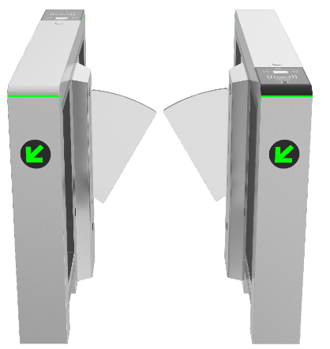
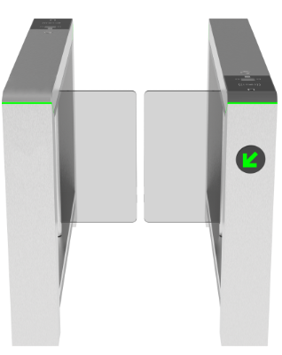
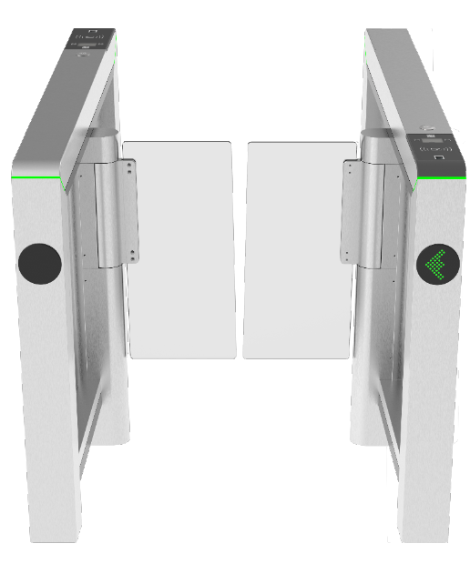
Mars Series of Turnstiles
Standard Version
The standard version is made of stainless steel.
Mars-F1000 Series
Mars-B1000 Series
Mars-S1000 Series
Notes:
F：Flap barrier
B: Swing barrier
S: Speed gates

Slide 5
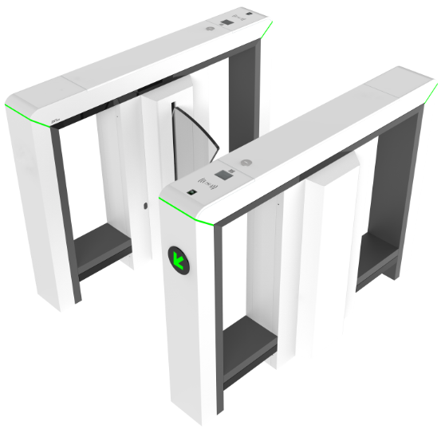
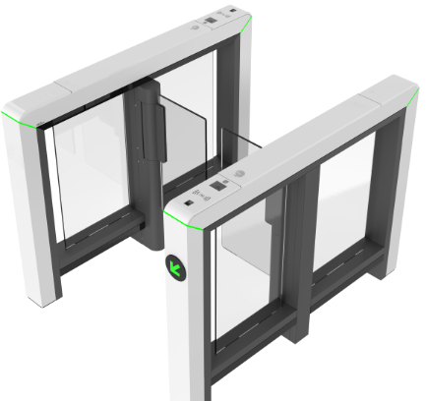
Mars Pro Series of Turnstiles
Premium Version
The premium version is made of SPCC material with white color powder coating.
Mars Pro-F1000 Series
Mars Pro-S1000 Series

Slide 6
Naming Rules
Mars-(F/B/S) (10/12) (00/11/22)
F: flap barrier
B: swing barrier
S: speed gates
10: single lane
12: dual lane
00: no reader and controller
11: with RFID+controller
22: with FP&FRID+controller

Slide 7
02
Product Design
  Biometric authentication panel
  Reservation hole for an additional device
  Infrared Sensor Extension
  Slot joint design
  Bottom lifting
  Exposed base plate

Slide 8
Product Design
Biometric authentication panel
Reservation hole for an additional device
IR sensor support extension
Post with slot joint
Bottom lifting
Exposed base plate
Notes:
代换图

Slide 9
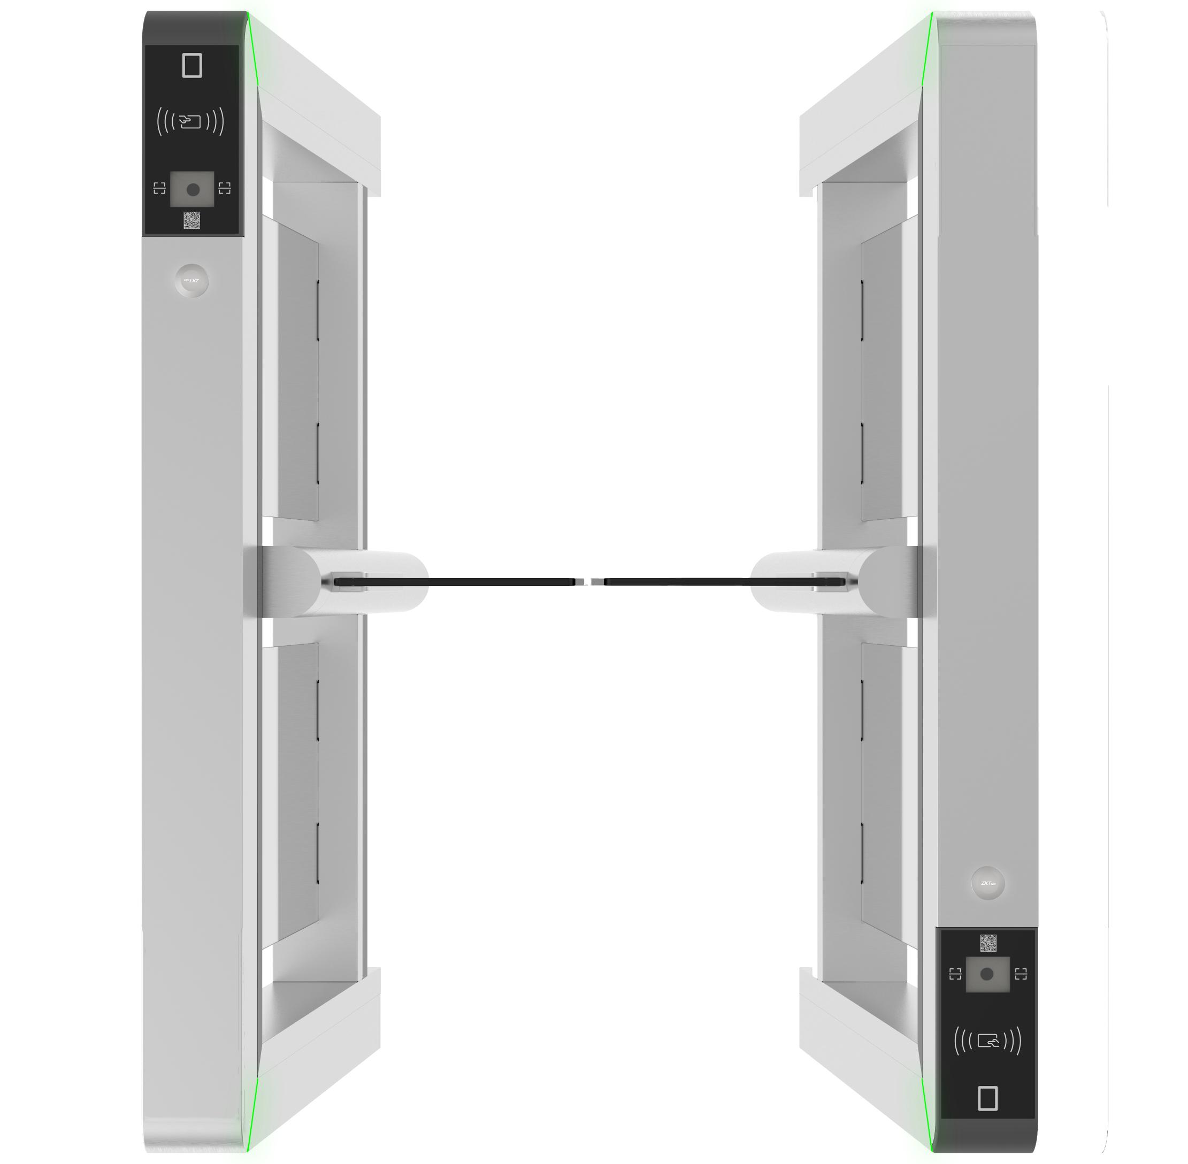
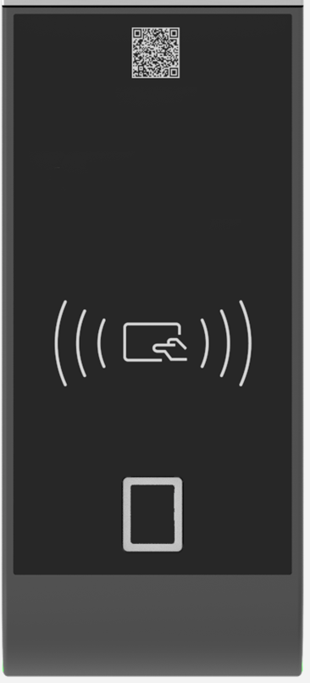
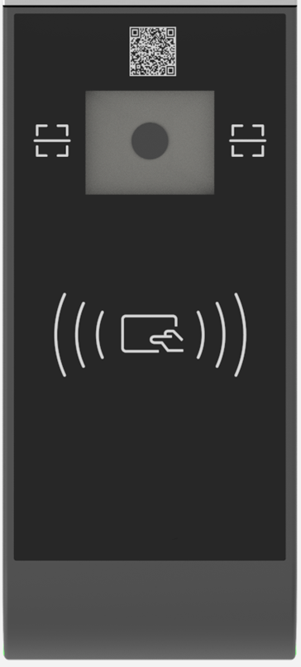
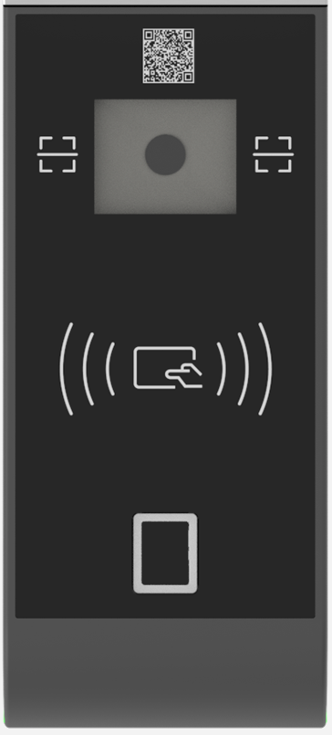

Authentication panel modular design
Multilabel biometric authentication panels are available. Easy to switch the panel as clients need.
RFID
RFID+FP
RFID+QR
RFID+FP+QR
Notes:
Up to 6 types of biometric authentication panels are available.

Slide 10
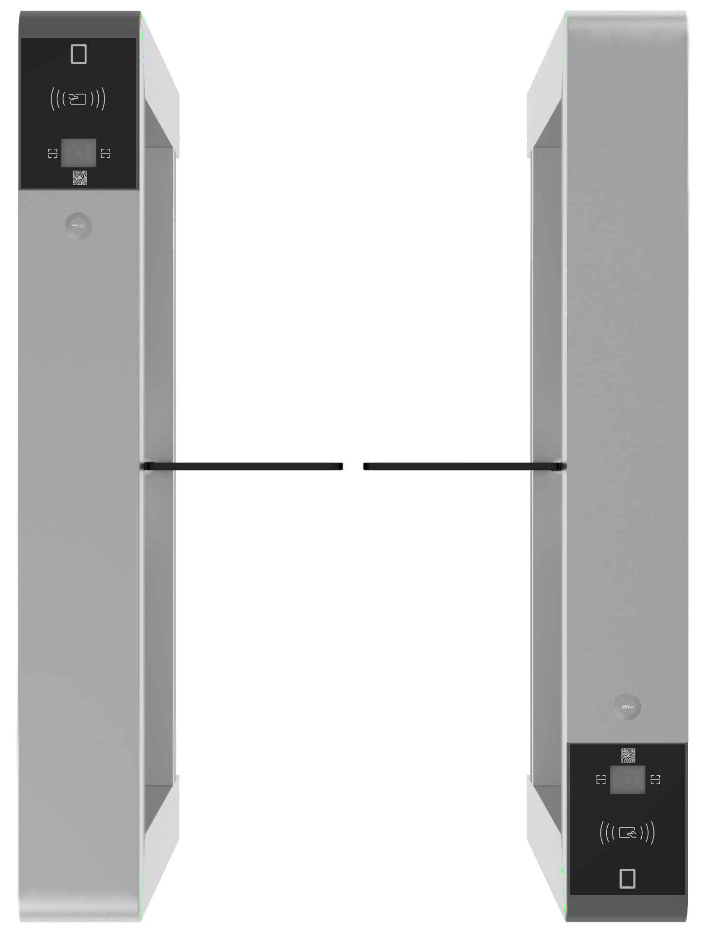
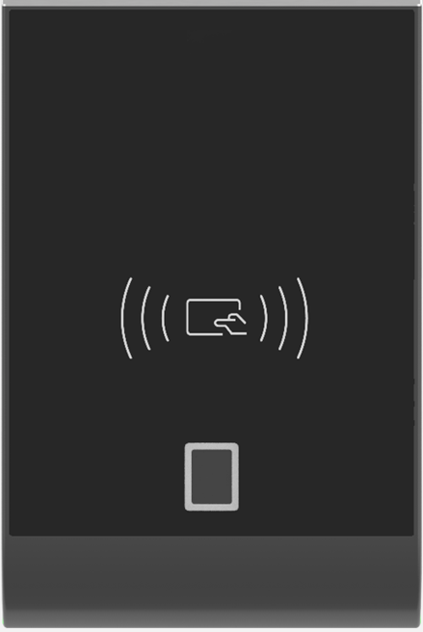
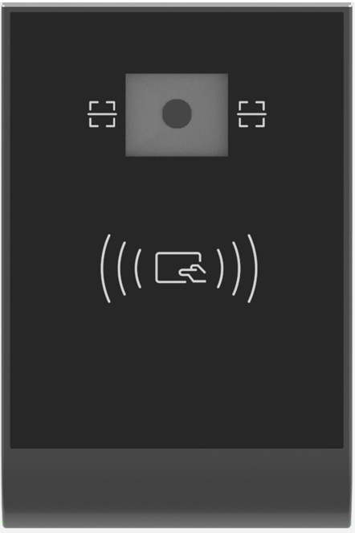
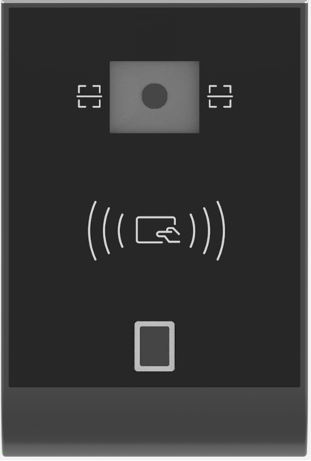

RFID
RFID+FP
RFID+QR
RFID+FP+QR
RFID+card box
RFID+QR+card box
Notes:
F1000 and B1000 series on Mars and Mars Pro have 2 more type with card box.

Slide 11
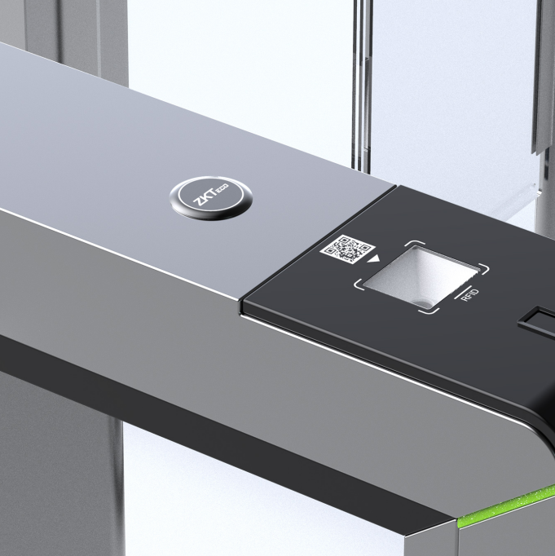
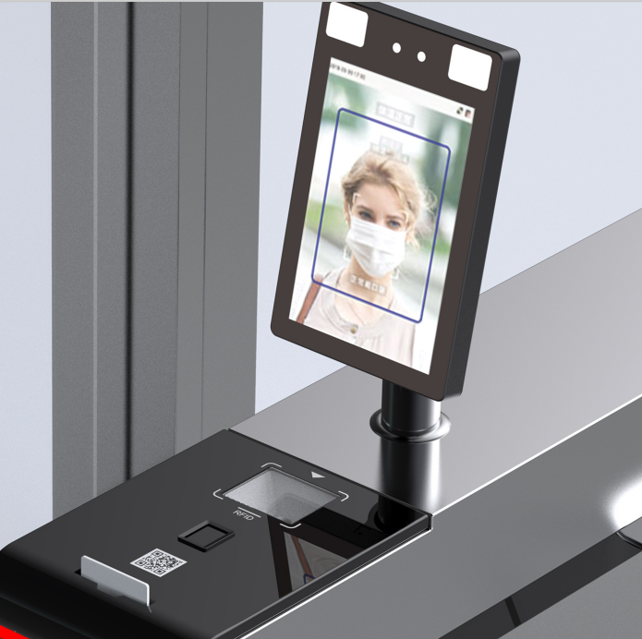
Reserved hole for additional device design
Reserved a hole with a diameter of 34mm and used a plastic cover to entirely cover this hole.
Clients could mount a facial recognition terminal with mask and temperature detection on the turnstile.

Slide 12
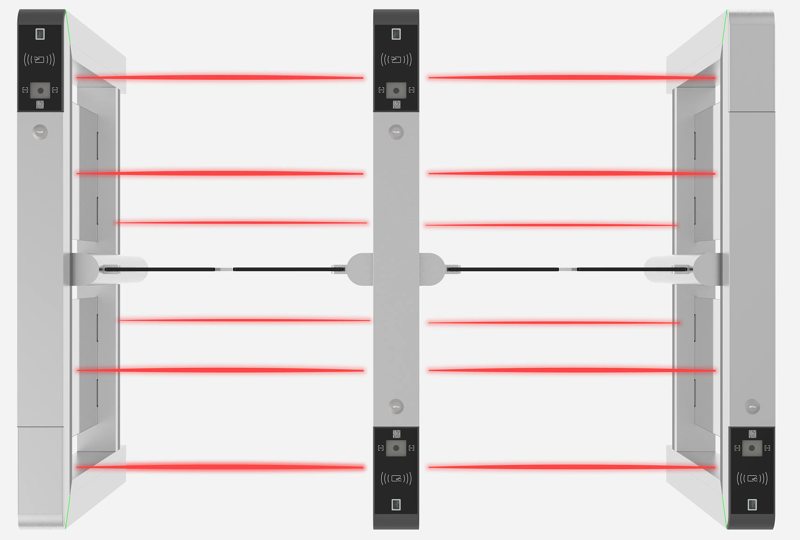
IR sensor extension design
The Series supports a maximum of 22 pairs of IR sensors, offering more accurate judgment and better anti-tailgating and anti-pinch performance.

Slide 13
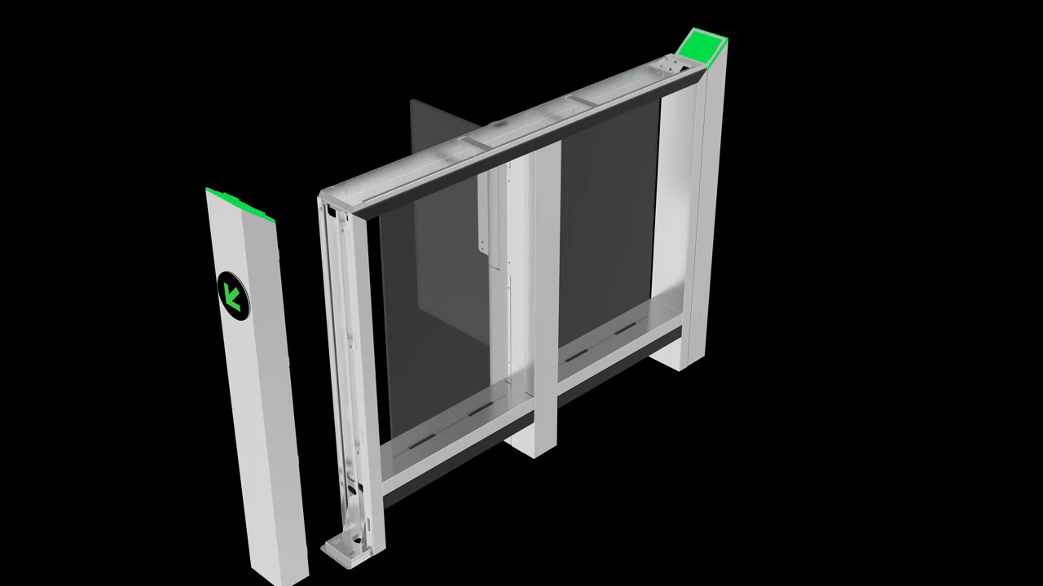
Slot jointed design
Both side POST using slot joint to fix. Easy install and remove.
Notes:
Benefits:
Easy maintenance for outside cabinet cover replacement
Make a components have the ability of material sharing, manufacture was more flexible and improve yield also.

Slide 14
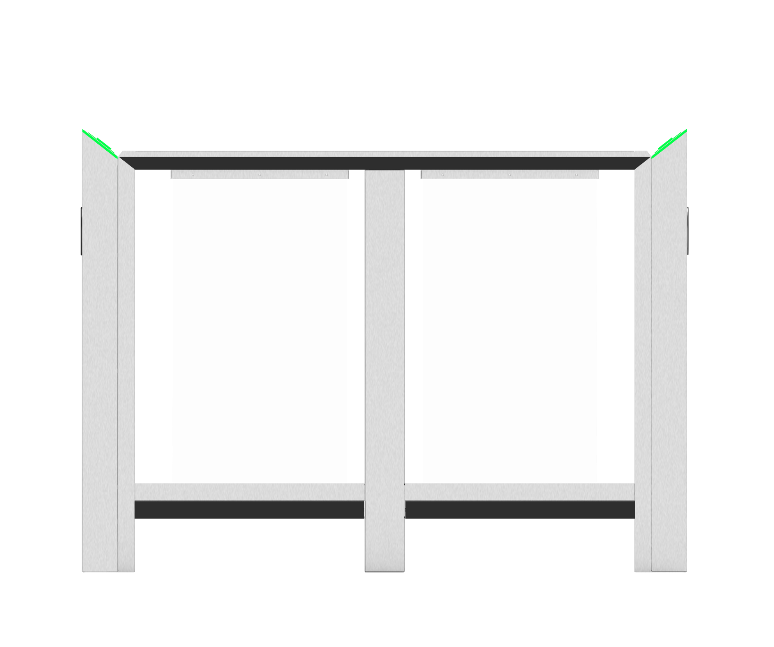
Bottom lifting design
Far away from ground 12cm to avoid moist environment impact device.
12cm

Slide 15
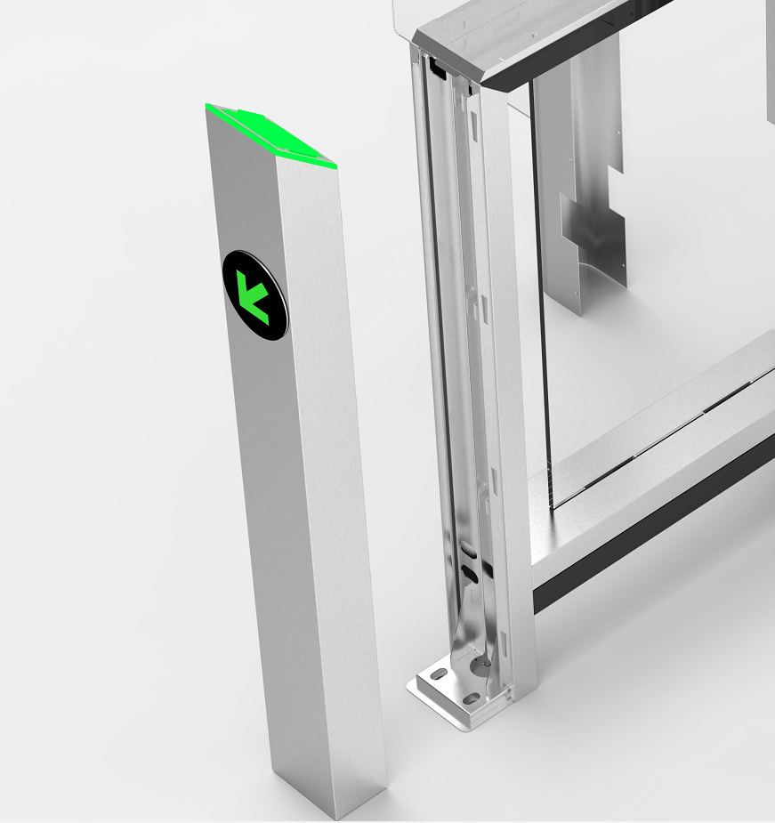
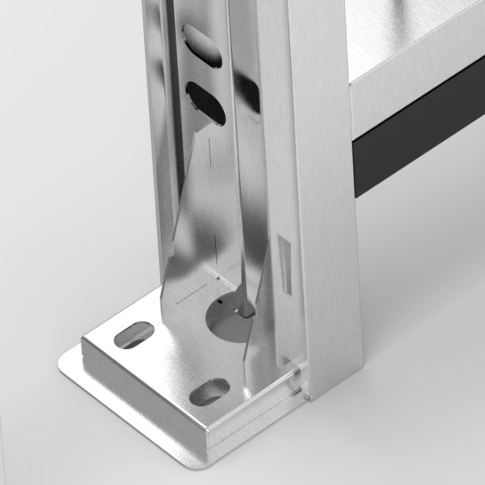
Be convenient to install device
It is easy to use tool fixing turnstile on the site.
Base plate of one side
Notes:
Note:
Each cabinet have to fix the base plate both side.

Slide 16
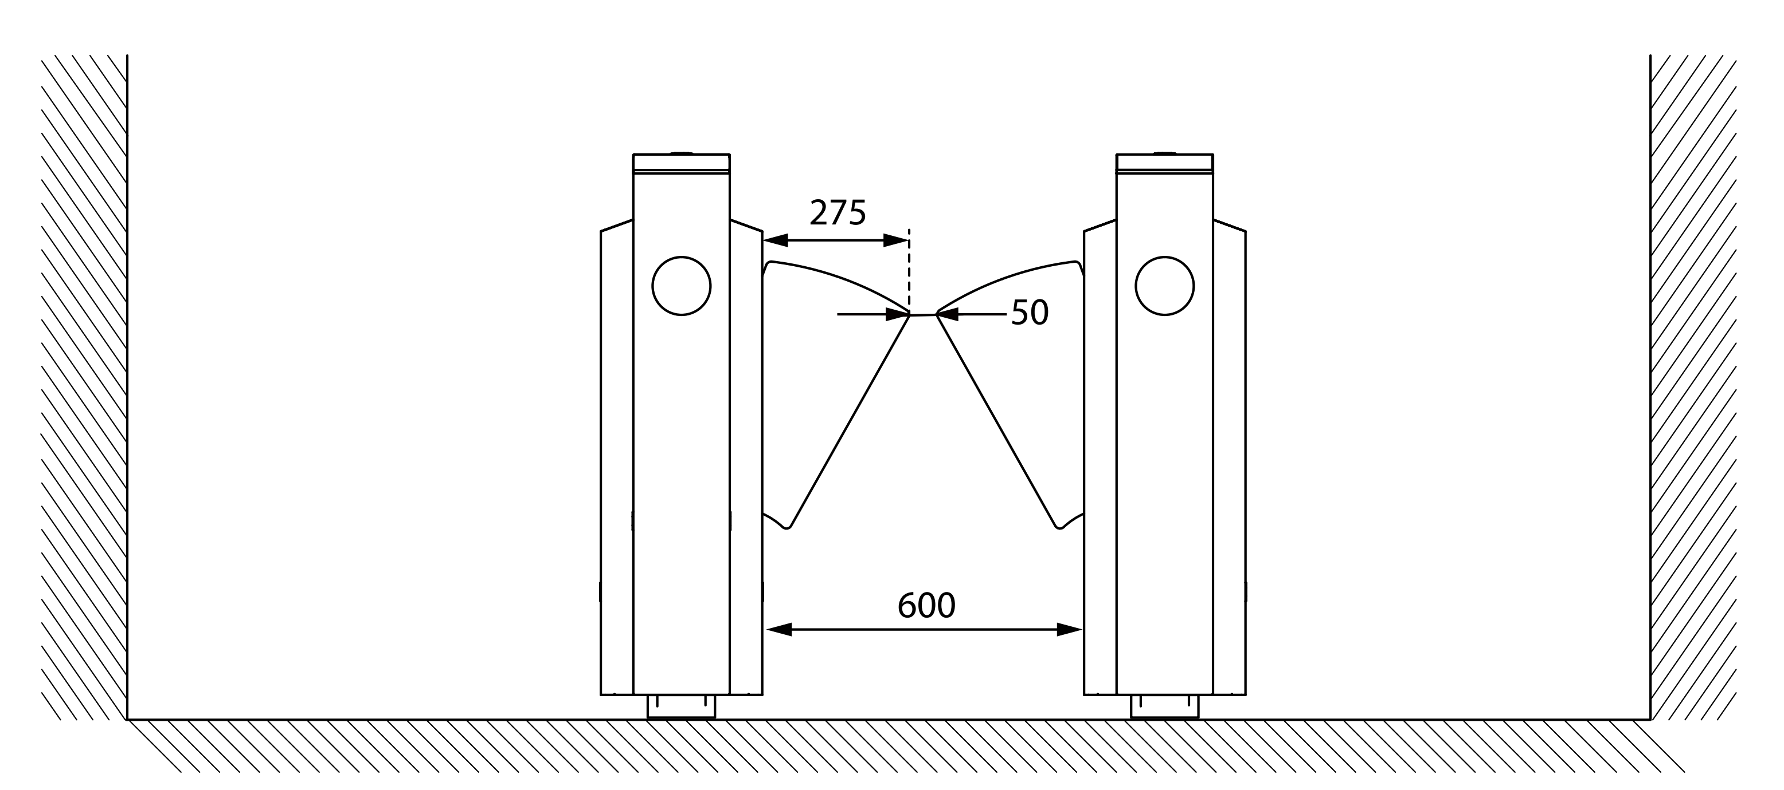


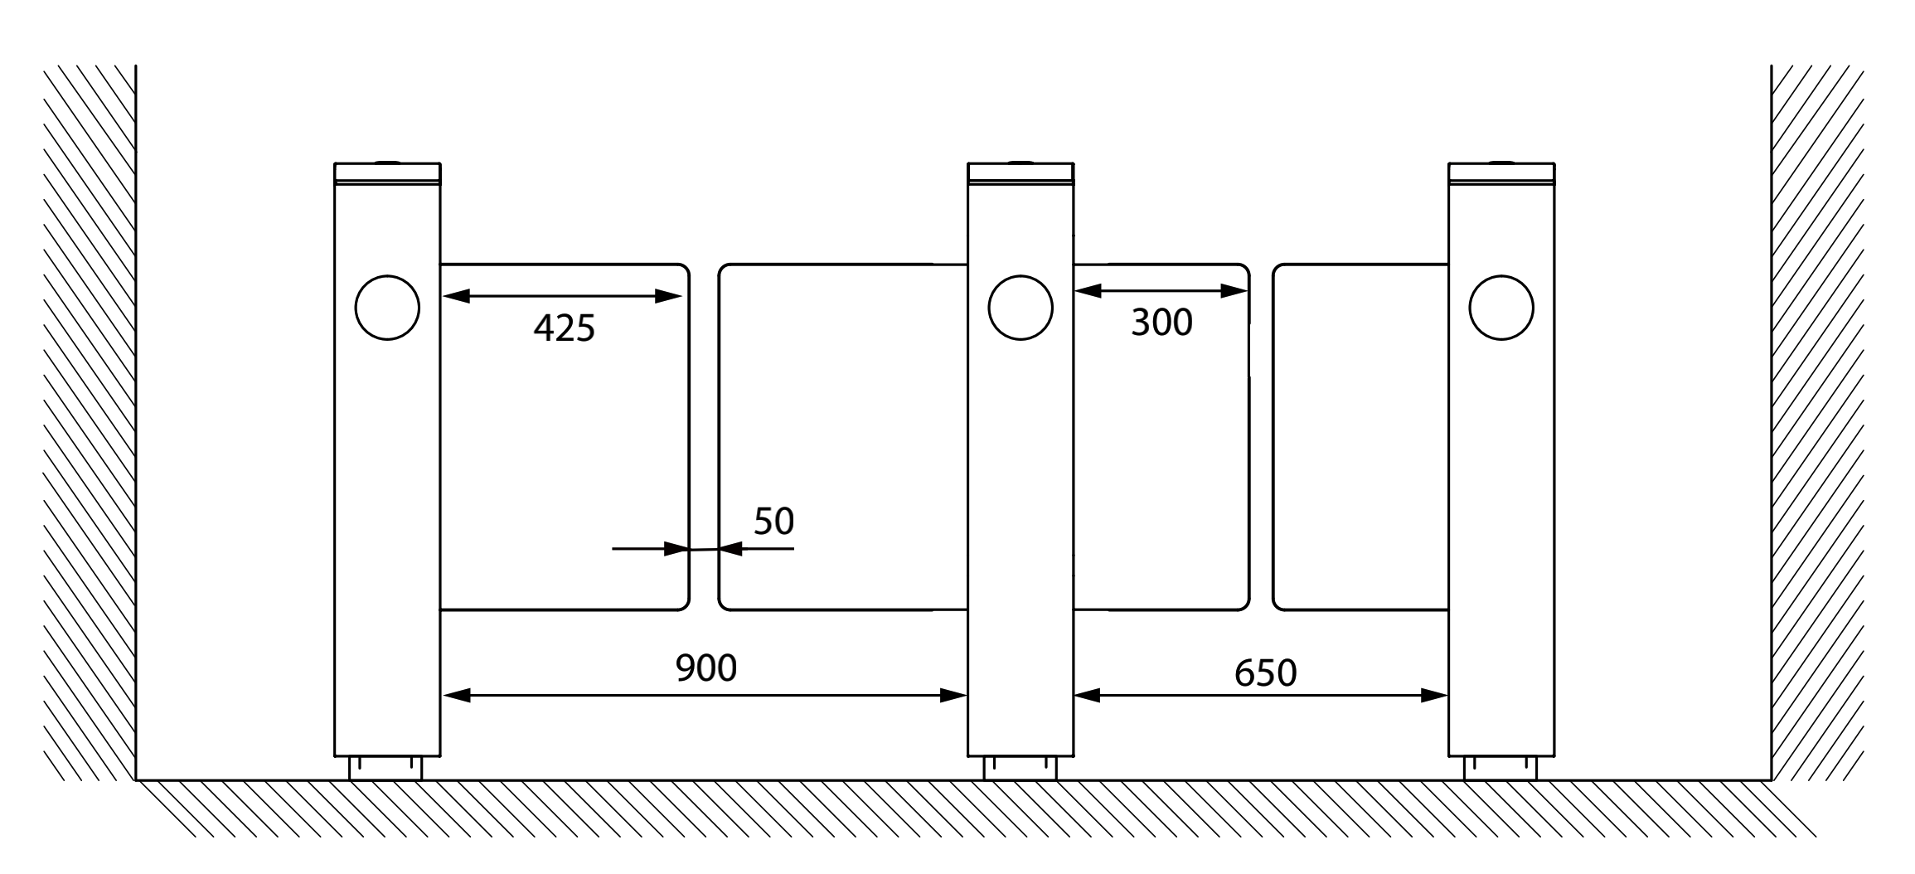

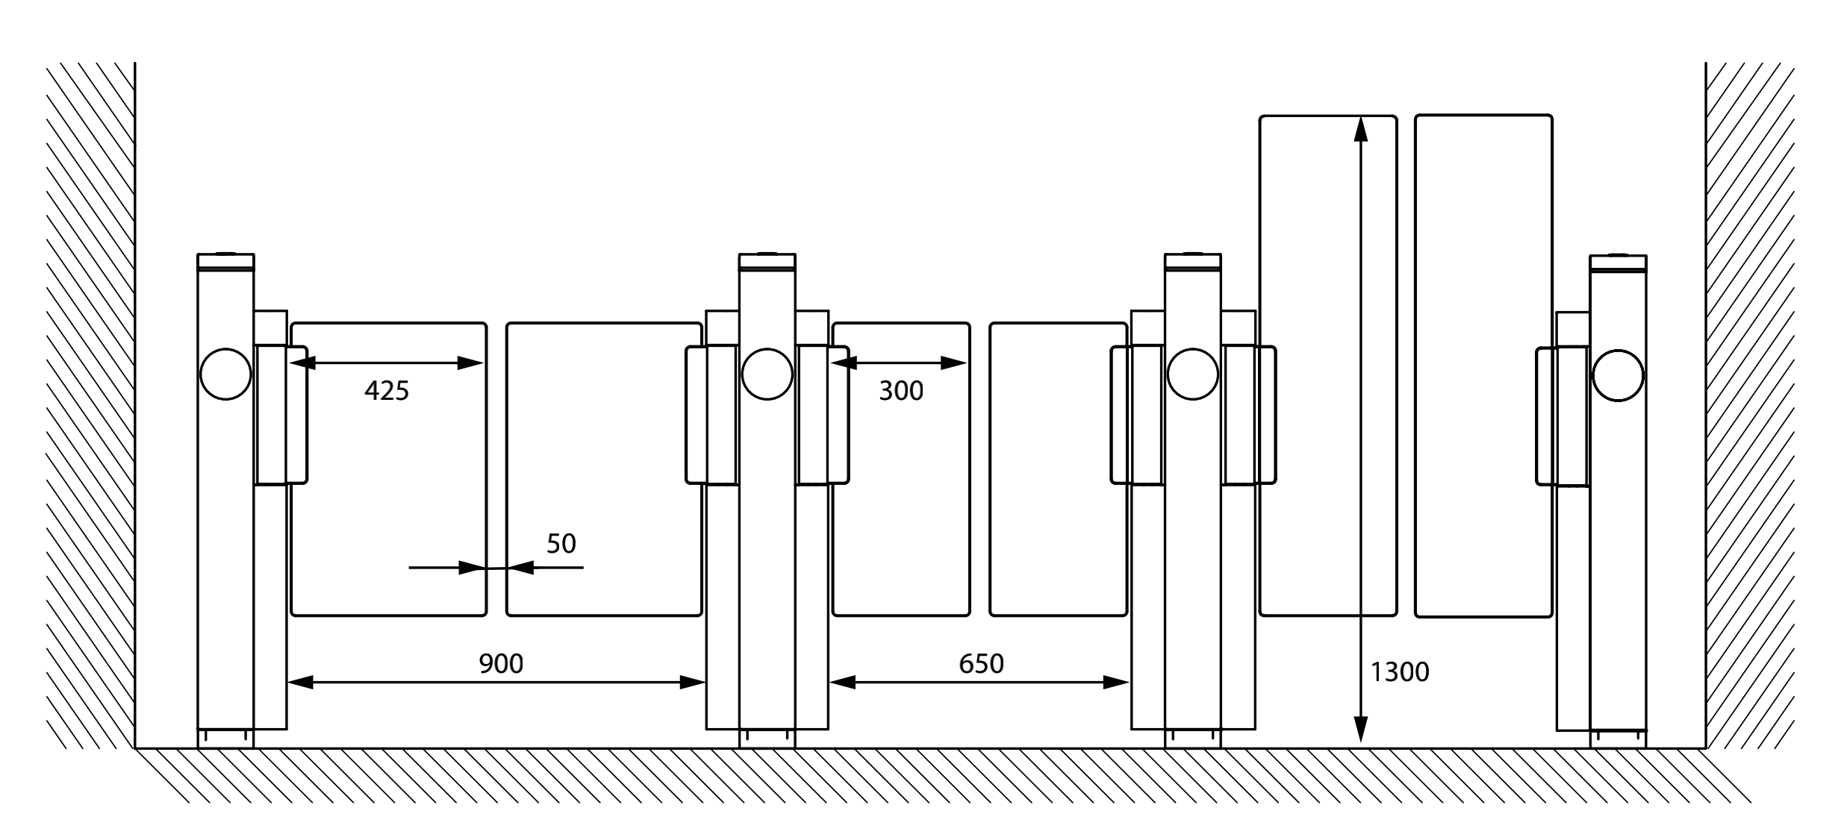


Lane type | Dimension | Model | Scene
Standard lane width | 600mm | Mars-F1000 Mars Pro-F1000
Wide lane width | 650~900mm | Mars-B1000 Mars-S1000 Mars Pro-S1000
Higher lane | 1500mm(height) | Mars Pro-S1000

Slide 17
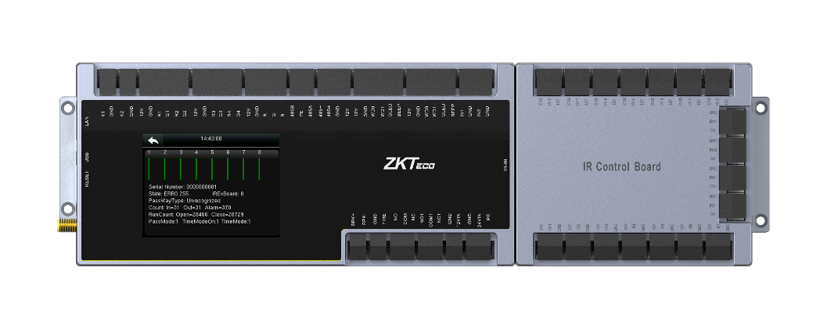
PGIC10 (Passage gate intelligent controller)
Access controller and turnstile controller 2-in-1 controller.
RS458 communication
Support TCP/IP or WIFI connection
With 2.8in touch screen
Card capacity is 10000
Fingerprint capacity is 3000
Log events capacity is 100000

Slide 18

Notes:
Video show

Slide 19
Mars and Mars Pro selling points
Selling points | Slot joint design | Reserved hole for facial device | IR sensor extension ability | MCBF | Delivery time shrink | Wide lane width | High barrier | Material and finishing | Bottom lifting
Mars series | √ | √ | Max 12 pairs | 3M, 5M (1 year warranty) | 3 weeks | 600~900mm |  | SUS304 | √
Mars Pro series | √ | √ | Max 22 pairs | 10M (5 years warranty) | 3 weeks | 600~900mm | √ (1500mm height) | SPCC & Powder coating | √

Slide 20
03
Product specification
  Key specification
  Internal products comparison
  External products comparison

Slide 21
Key Specifications
Model Name | MCBF | Dimensions (mm) | Barrier Material | Cabinet material | Emergency Mode | IR Sensor (QTY)
Mars-F1000 Series | 3M | 1360*180*1010 | Acrylic | SUS304 | Y | 5 pairs
Mars-B1000 Series | 5M | 1360*180*1010 | Acrylic | SUS304 | Y | 6 pairs
Mars-S1000 Series | 5M | 1360*120*1020 | Acrylic | SUS304 | Y | 8 pairs
Mars Pro-F1000 Series | 10M | 1360*180*1010 | Acrylic | SPCC | Y | 16 pairs
Mars Pro-S1000 Series | 10M | 1360*120*1020 | Acrylic | SPCC | Y | 20 pairs

Slide 22
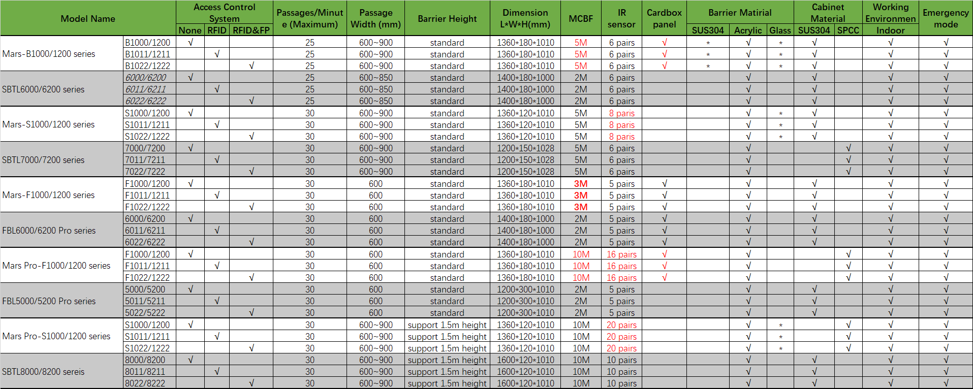
Internal products comparison

Slide 23
External products comparison
Type Brand | Flap barrier | Flap barrier | Swing barrier | Swing barrier | Swing barrier
ZKTeco | F1000 MCBF>3m, brushless motor, 5 pairs of IR sensors | Pro-F1000 MCBF>10m, brushless motor, 16 pairs of IR sensors | B1000 MCBF>5m, brushless motor, 6 pairs of IR sensors | S1000 MCBF>5m, brushless motor, 8 pairs of IR sensors | Pro-S1000 MCBF>10m, Servo motor, 20 pairs of IR sensors
Brand A | MCBF>5m, brushless motor,5 pairs of IR sensors |  | MCBF>5m, brushless motor. 4 pairs of IR sensors |  | MCBF>5m, brushless motor, 10 pairs of IR sensor
Brand B | MCBF>3m, brushless motor |  |  | MCBF>3m, brushless motor
Brand C |  | MCBF>6M, Servo motor, 12 pairs of IR sensors | MCBF>6M, Servo motor, 12 pair of IR sensors | MCBF>6M, Servo motor, 12 pairs of IR sensors | MCBF>6M, Servo motor, 24 pairs of IR sensors
Brand D |  |  | MCBF>5M, Servo motor, 12 pairs of IR sensors | MCBF>5M, Servo motor, 12 pairs of IR sensors | MCBF>5M, Servo motor, 20 pairs of IR sensors
Brand E |  | MCBF>15M, brushless motor, 13 pairs of IR sensors |  |  | MCBF>15M, brushless motor, 8 pairs of IR sensors
Notes:
解释不太容易懂

Slide 24
Mars and Mars Pro
Series Features
COST
Delivery
Flexibility
Modularization: Prices are more competitive, and products could be shipped and delivered more quickly
Access reader panels reduces middlemen’s or users’ inventory pressure and installation time & expenses
Easy installation
Reliability
Only removing 4 pcs screw, you can access all the interior components.
MCBF of the standard version device is proven to be over 2M, while what of the premium version is proven to be up to 10M. The Series supports 5-year warranty.

Slide 25
04
Products applications
  Sports Halls
  Elevator Lobbies
  Offices
  Stations
  Exhibition Centers

Slide 26
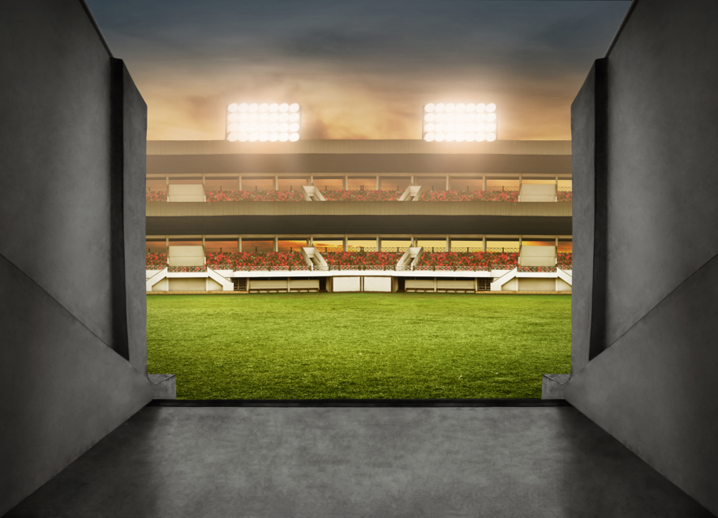
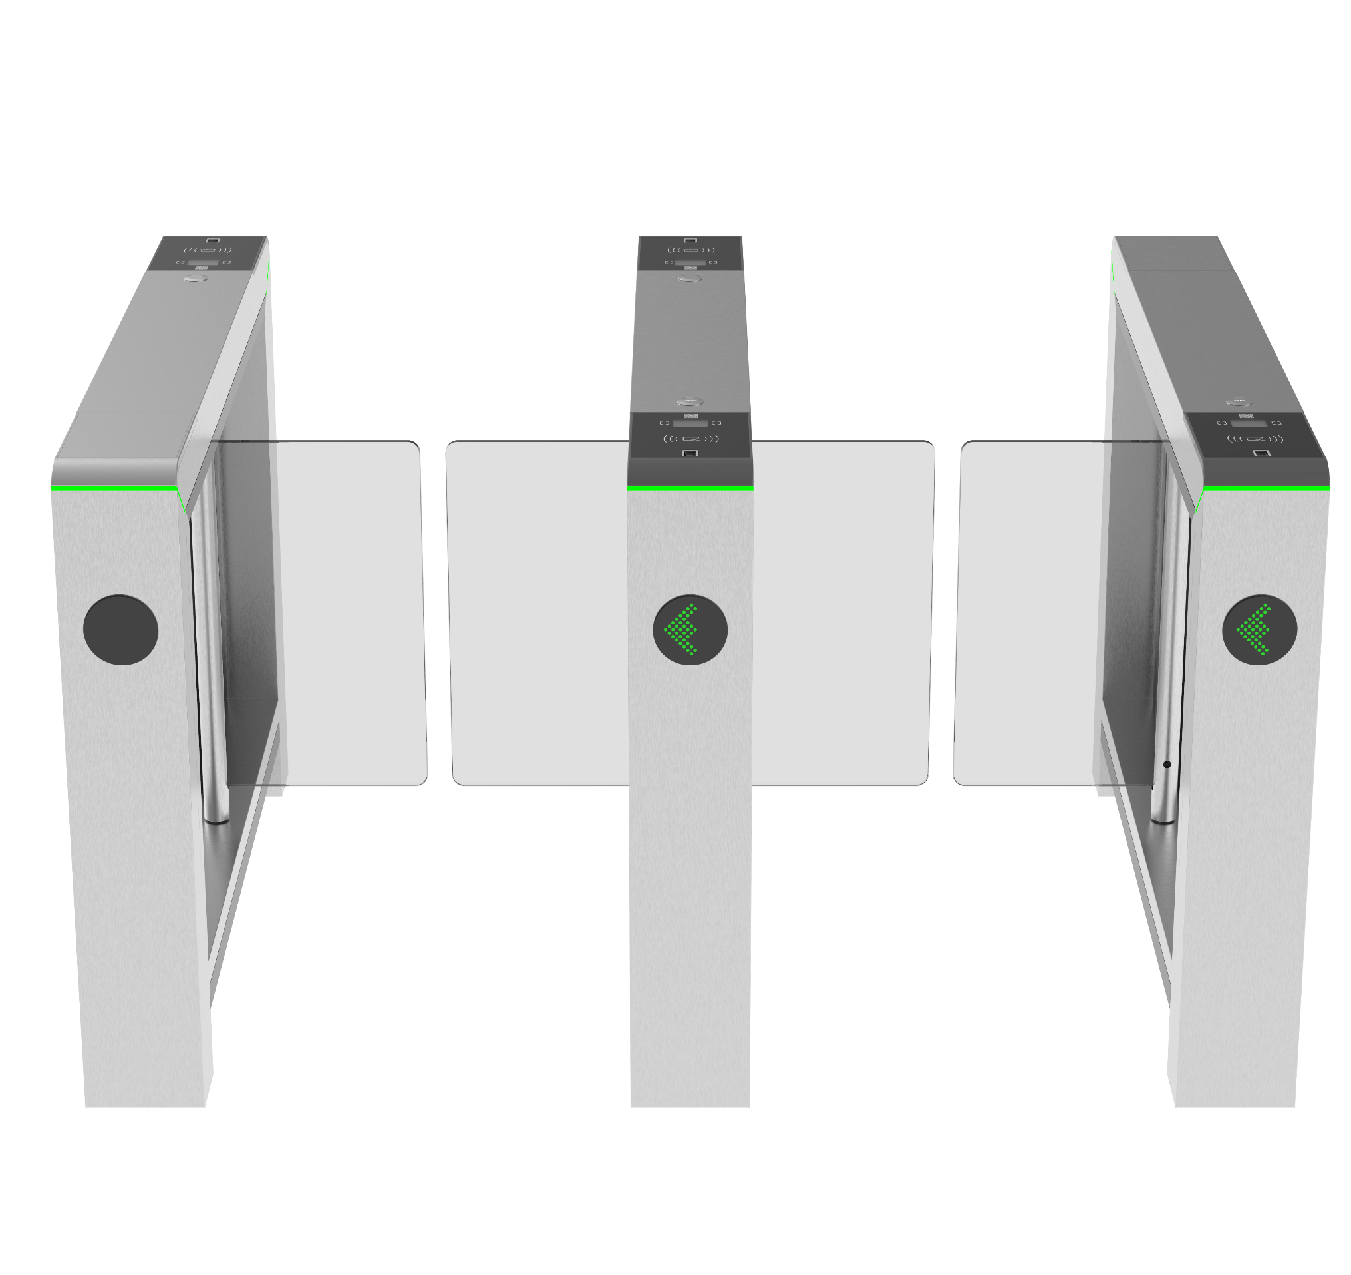
Applications
Sport Halls
Device recommended: Mars-B1000 Series
Obvious indicator guidance
Wide lane width of 900mm
IR sensors that detect abnormal situation and trigger alarm
Support stainless steel barrier with better anti-collision ability

Slide 27
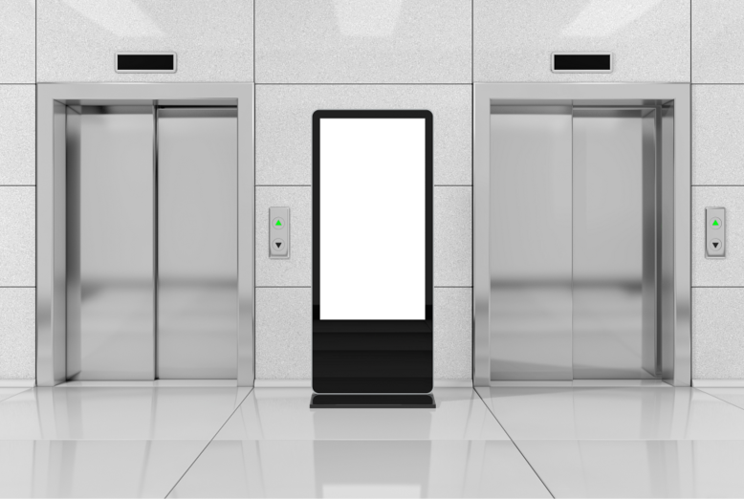
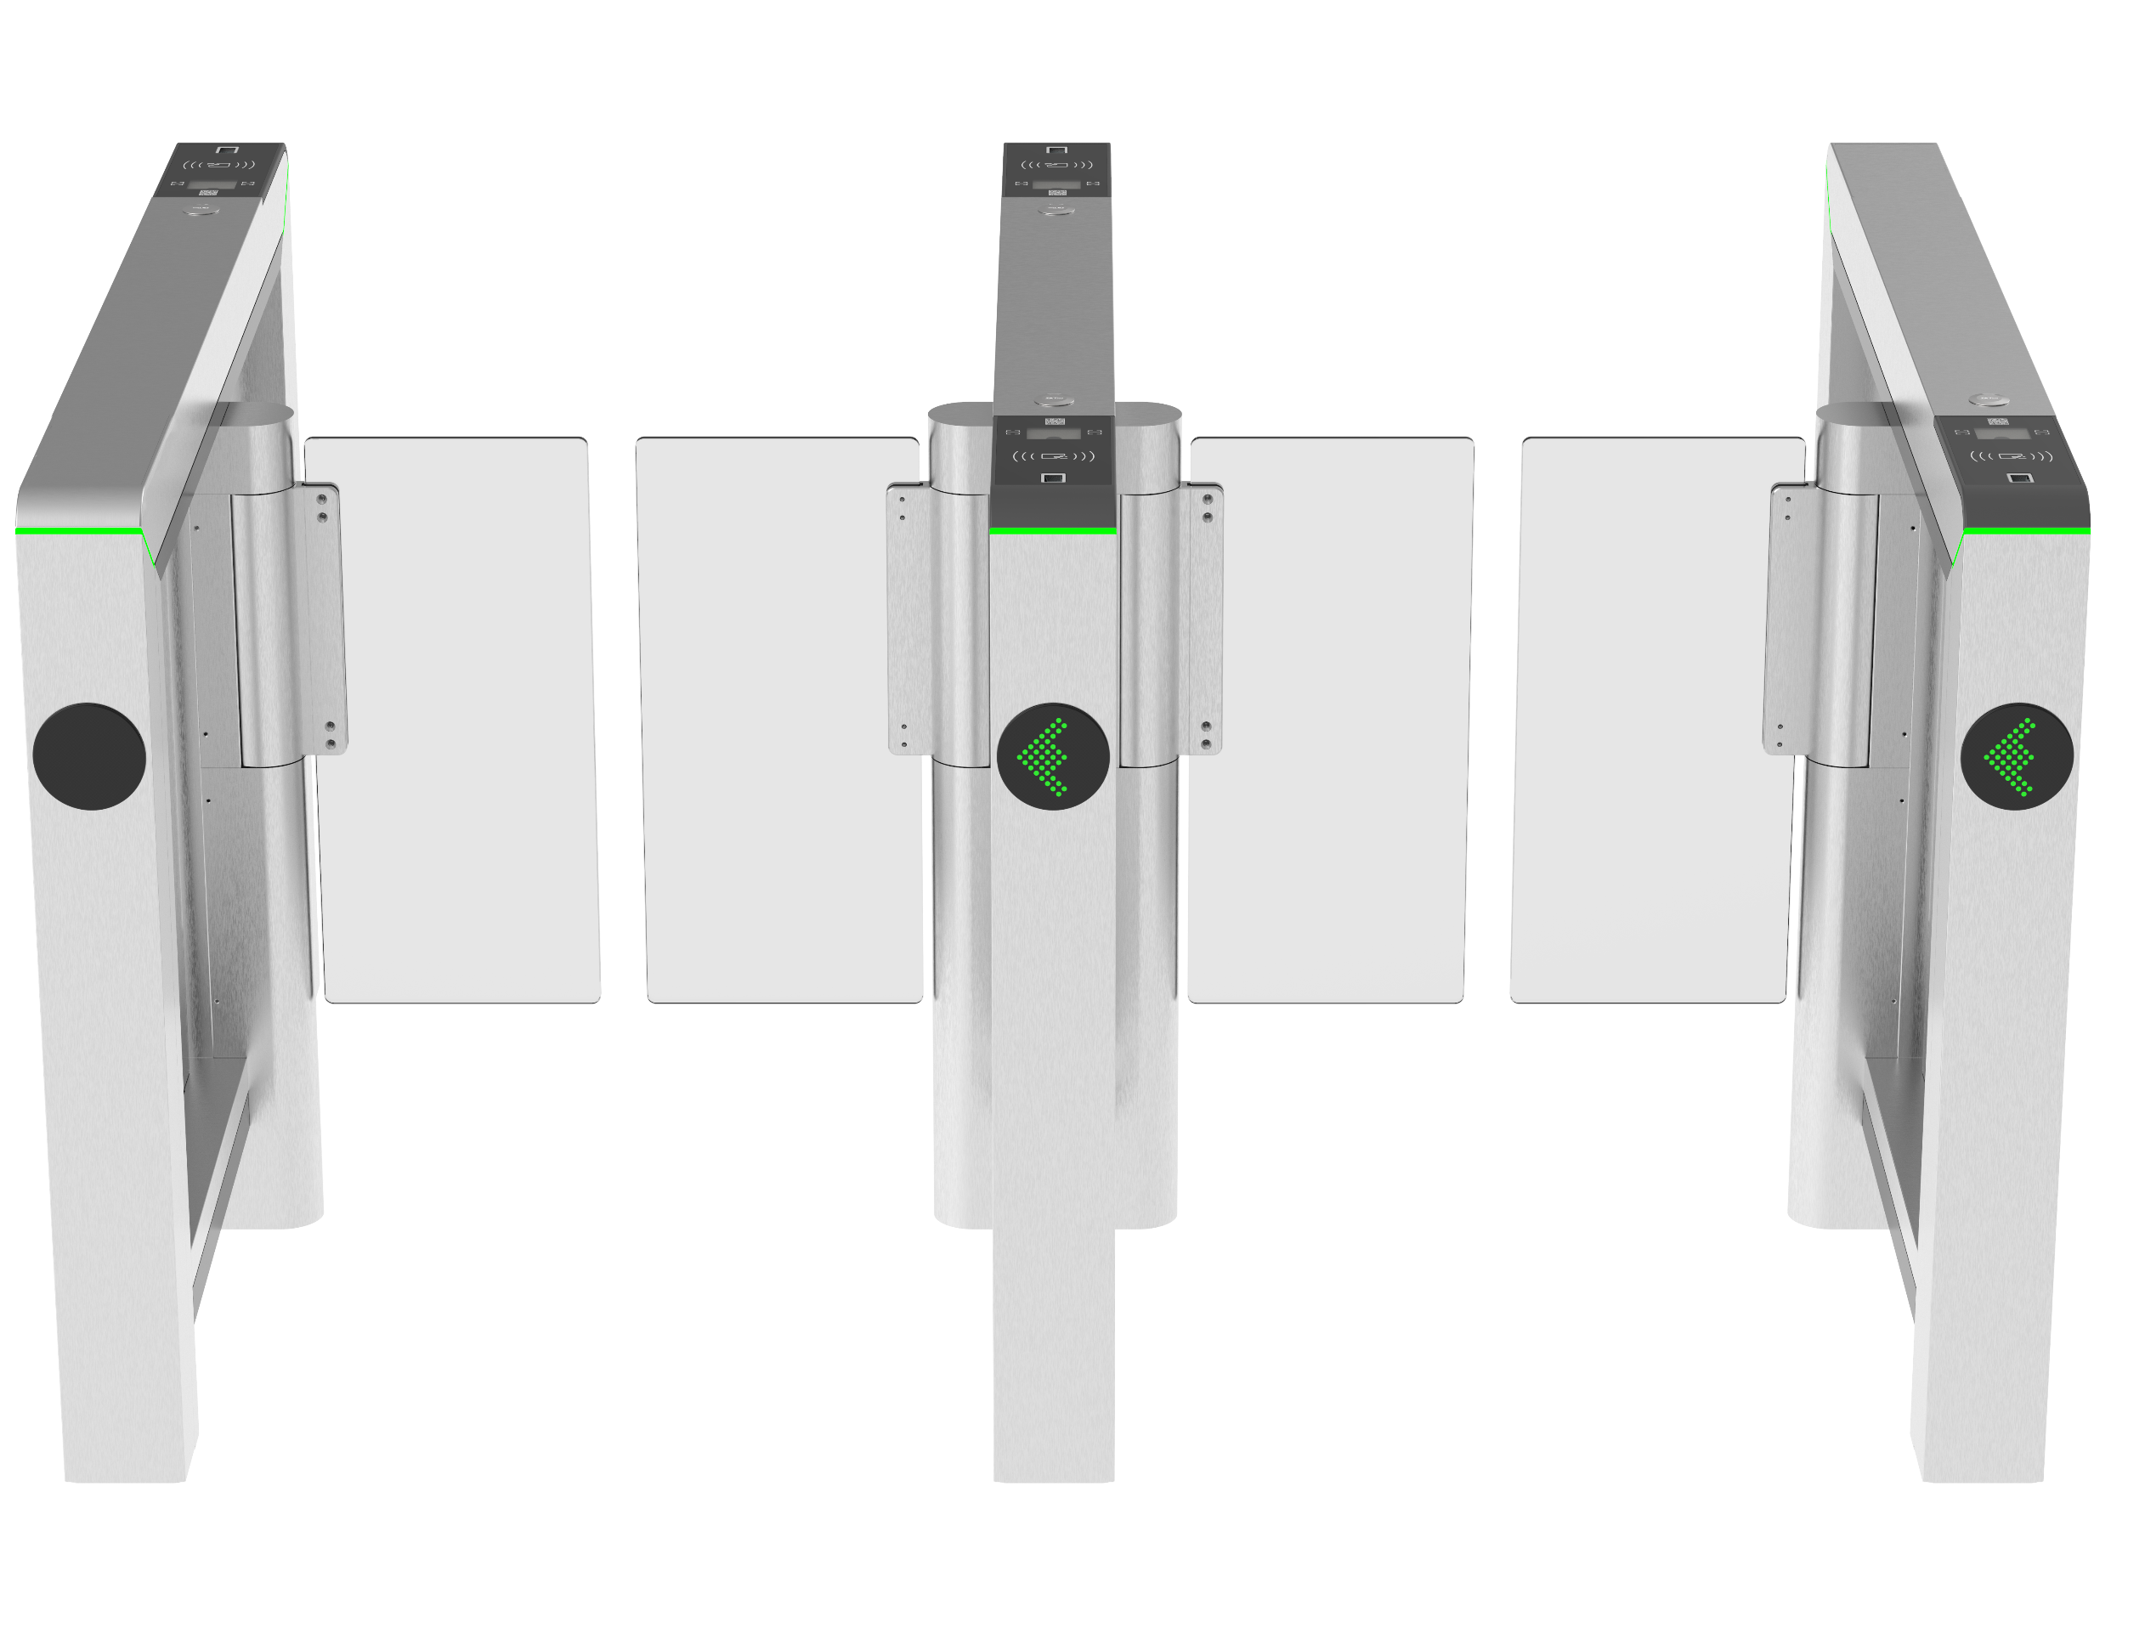
Applications
Elevator Entrances
Device recommended: Mars-S1000 Series
Obvious indicator guidance
Faster opening/closing speed
Wide lane width of 900mm
Support QR reader panel for visitor entrance solution
Device with 120mm narrow cabinet.

Slide 28

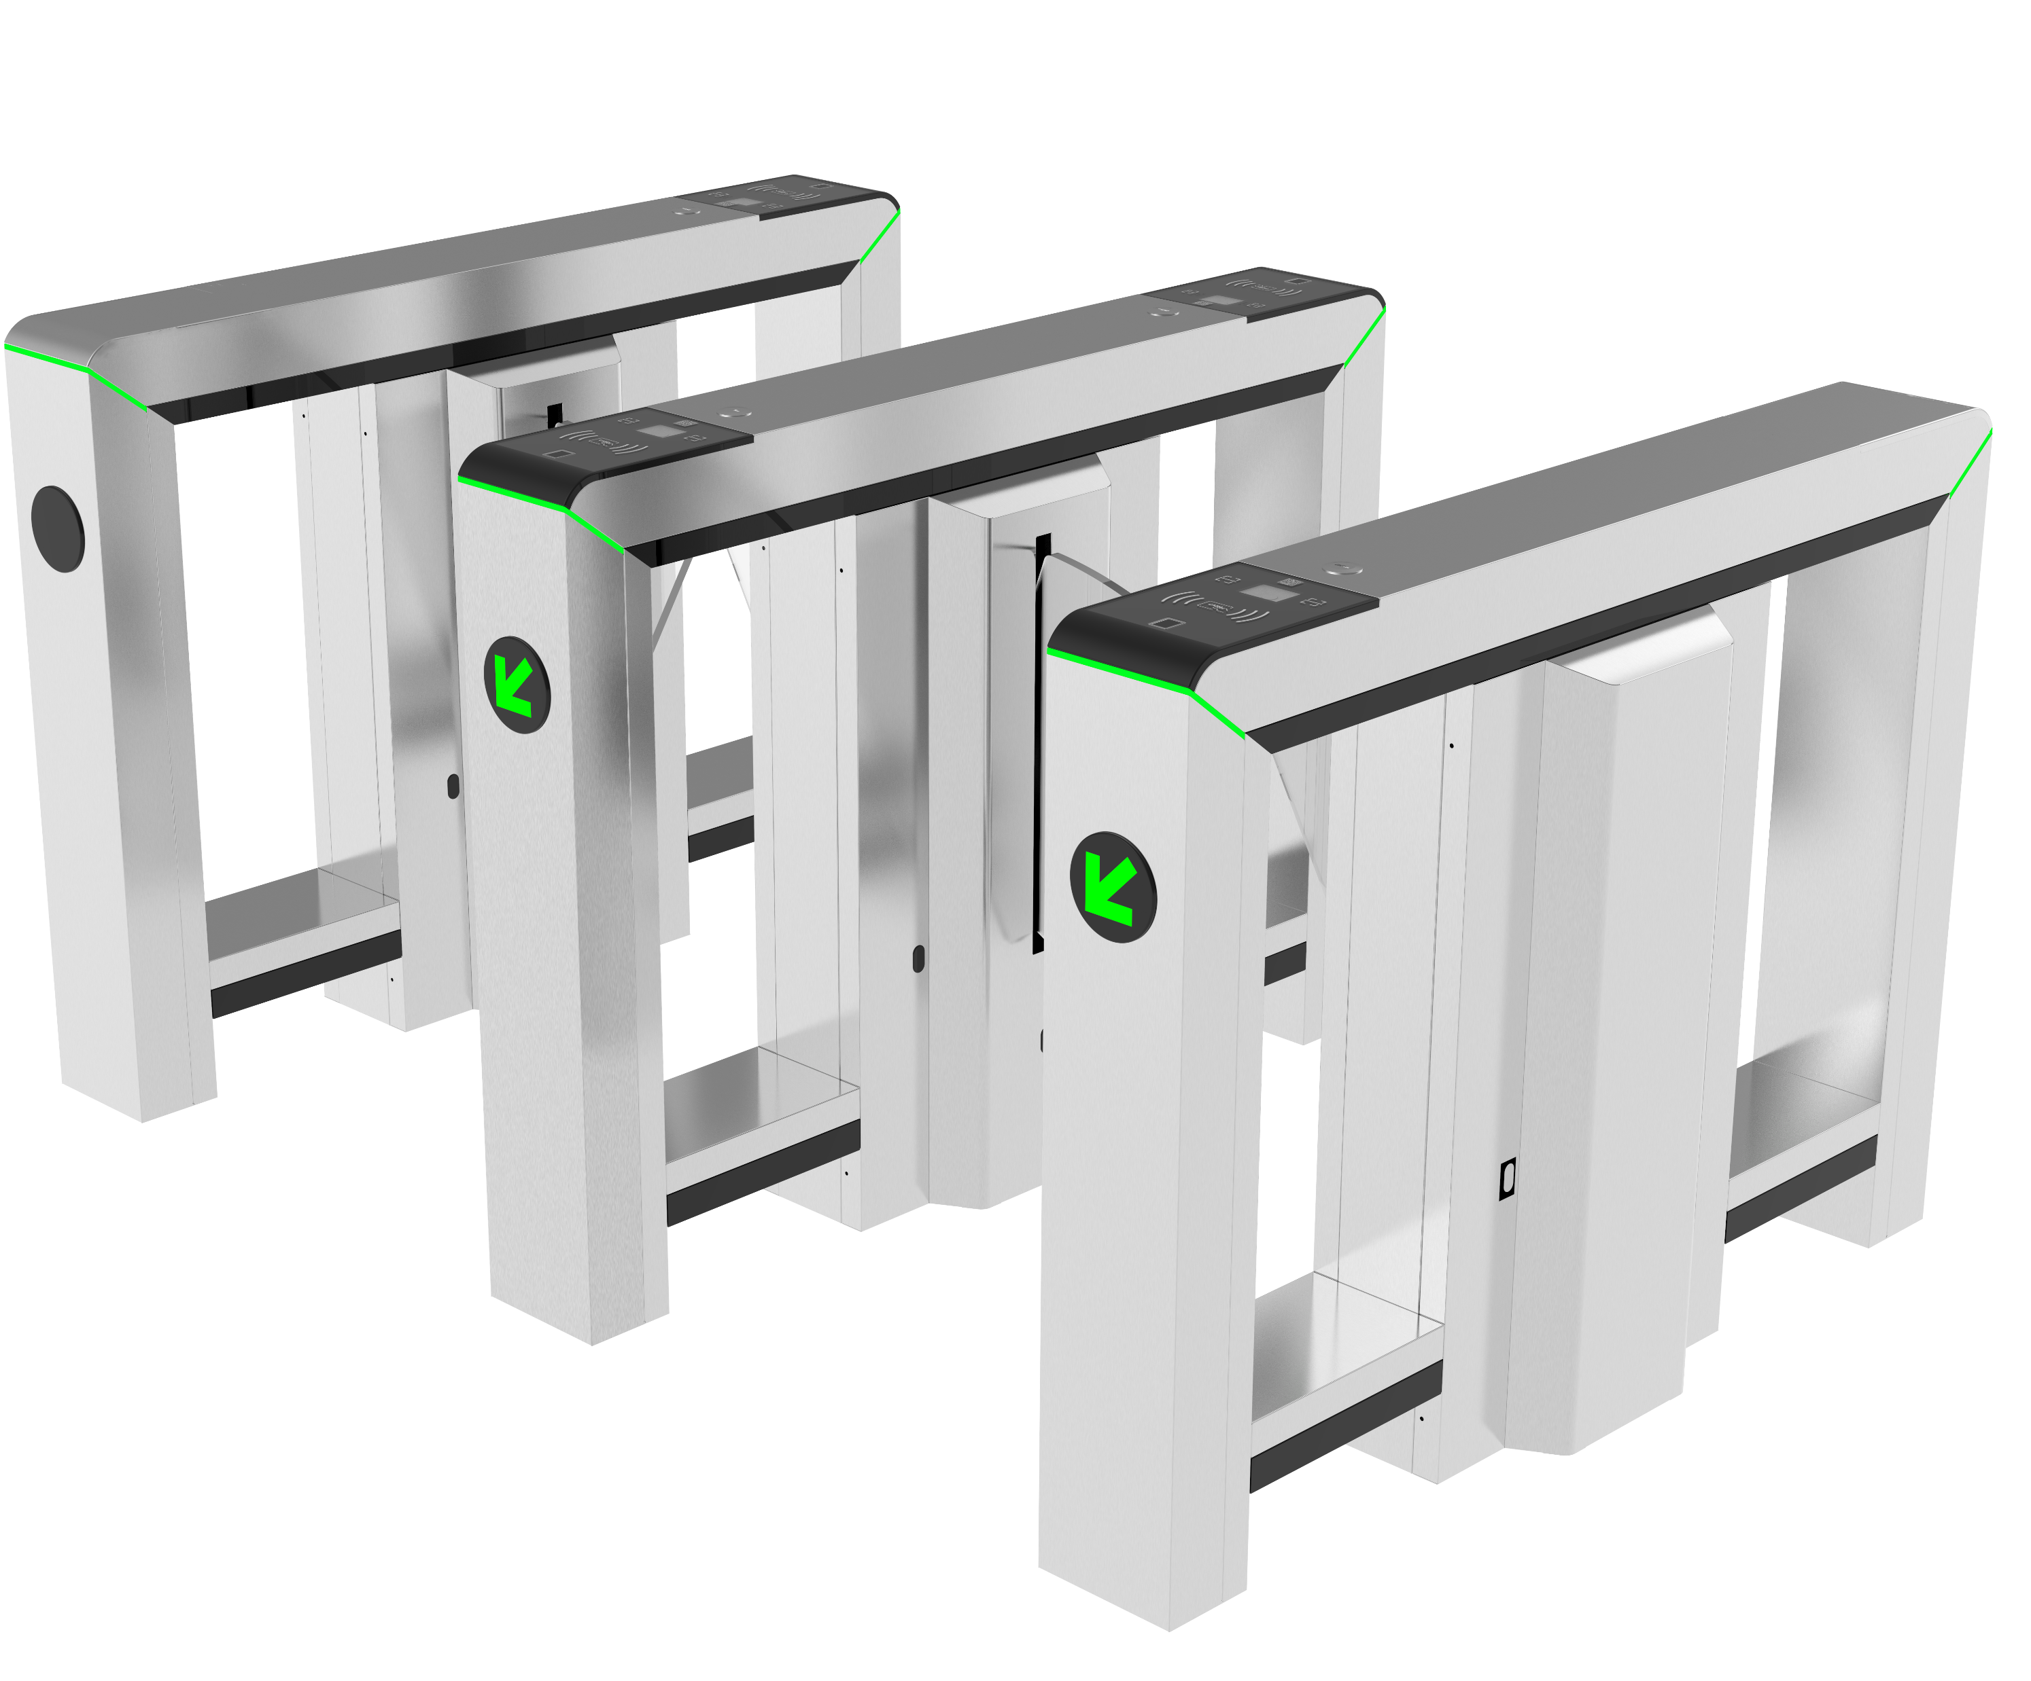
Applications
Office Areas
Device recommended: Mars-F1000 Series
Obvious indicator guidance
Faster opening/closing speed
Automatic opening during emergency
Different multi-biometric identification reader panels available

Slide 29
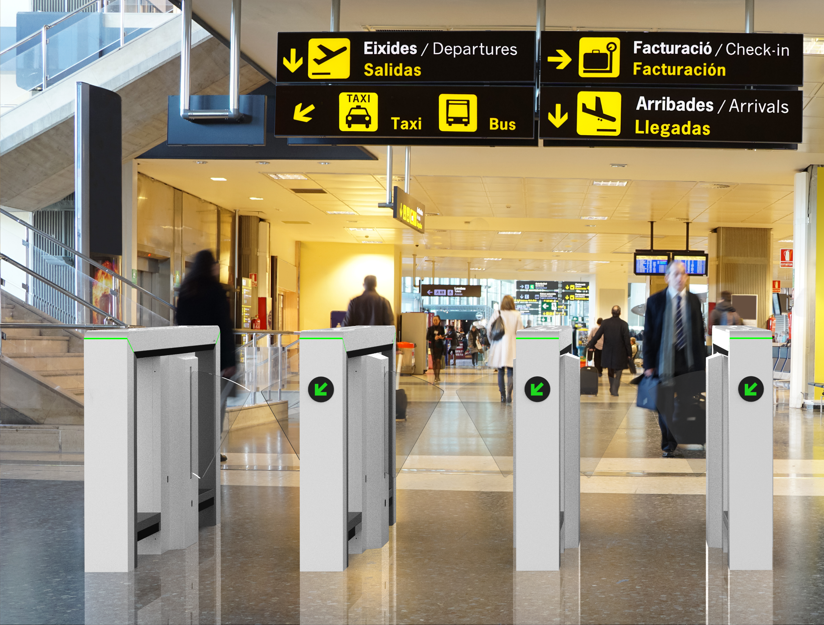
Applications
Stations
Device recommended: Mars Pro-F1000 Series
Obvious indicator guidance
Faster opening/closing speed
Automatic opening during emergency
Anti-tailgate ability better then swing barrier
MCBF up to 10 millions, support 5 years warranty

Slide 30
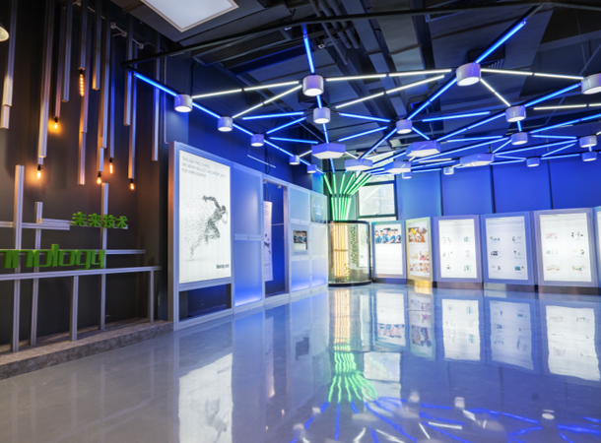
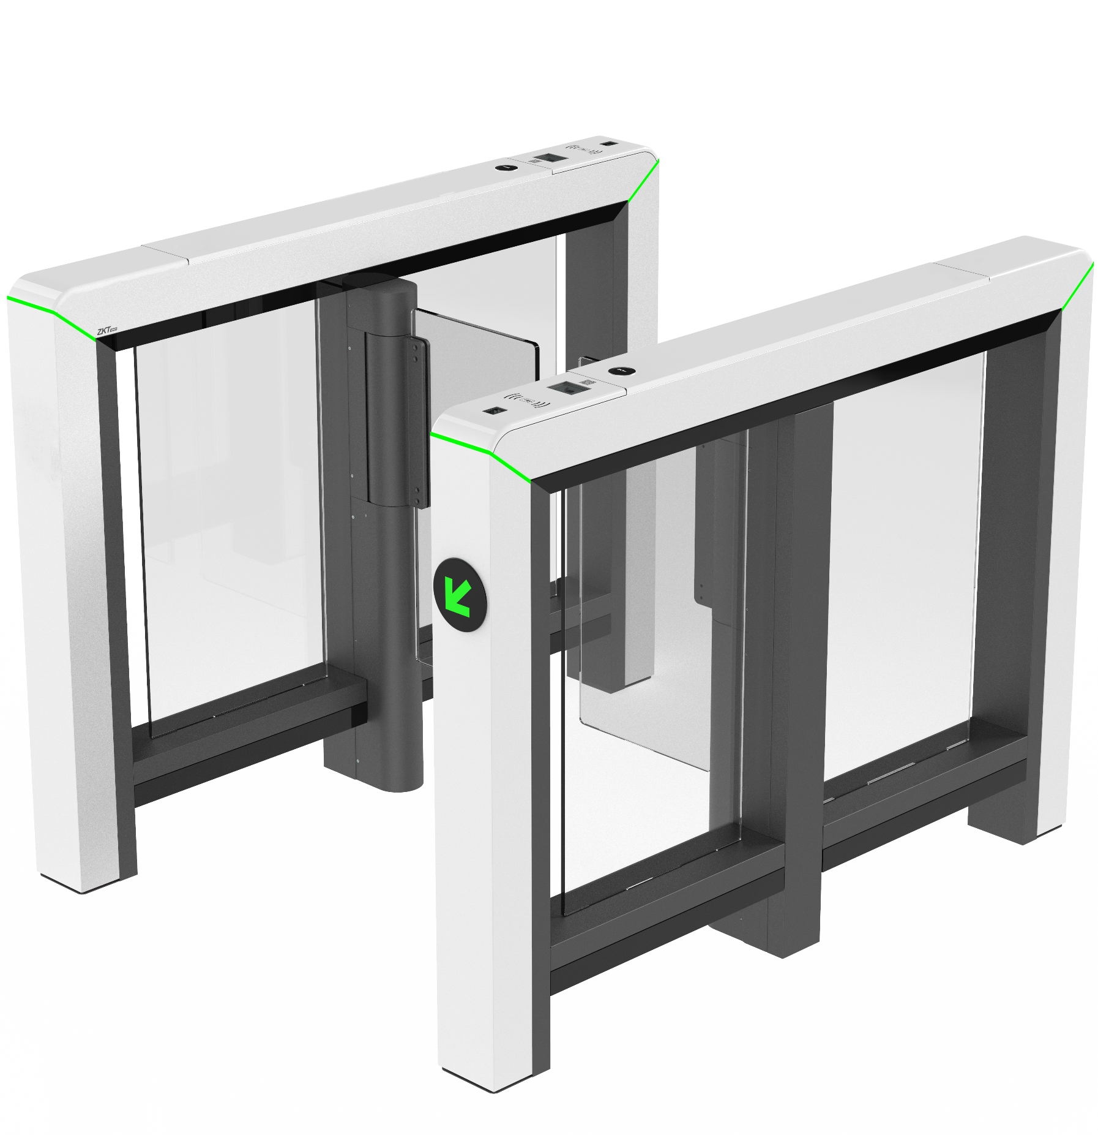
Applications
Exhibition Centers
Device recommended: Mars Pro-S1000 Series
Obvious indicator guidance
Faster opening/closing speed
Wide lane width of 900mm
Barrier height support 1500mm with high security level
Different multi-biometric identification reader panels available
MCBF up to 10 millions, support 5 years warranty.

Slide 31
BIOMETRICS & COMPUTER VISION
THANK YOU!

