Slide 1
BIOMETRICS & COMPUTER VISION
ZKTeco’s Turnstiles
Mars Series
& Mars Pro Series

Slide 2
CONTENT
1. Introduction
3. Installation
Mars Series:
B1000 Series, F1000 Series, S1000 Series
Mars Pro Series:
F1000 Series, S1000 Series
Lane Width
Base Plate
4. Market Positioning Analysis
2. Modularized Design
Comparison with ZKTeco’s Similar Products
Comparison with Competitors’ Similar Products
Sandwich Structure
Authentication Panel
Reserved a Place for Facial Recognition, Temperature and Mask Detection Terminals
Infrared Sensor Extension
5. Applications
Sports Halls
Elevator Lobbies
Offices

Slide 3
01
Introduction
Mars Series:
B1000 Series, F1000 Series, S1000 Series
Mars Pro Series:
F1000 Series, S1000 Series

Slide 4
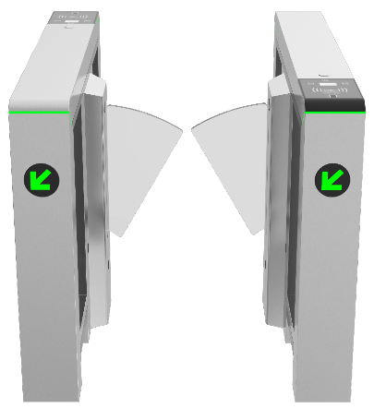
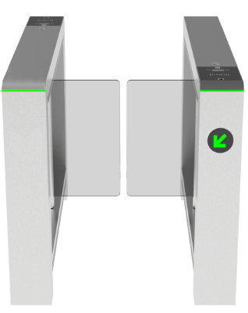
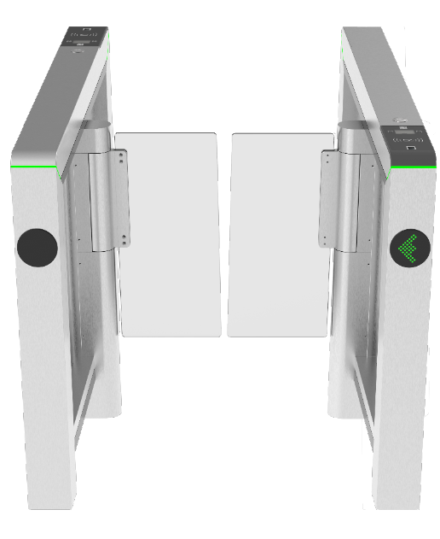
Mars Series of Turnstiles
Standard Version
The standard version is made of stainless steel.
Mars-F1000 Series
Mars-B1000 Series
Mars-S1000 Series
Notes:
F：Flap barrier
B: Swing barrier
S: Speed gates

Slide 5
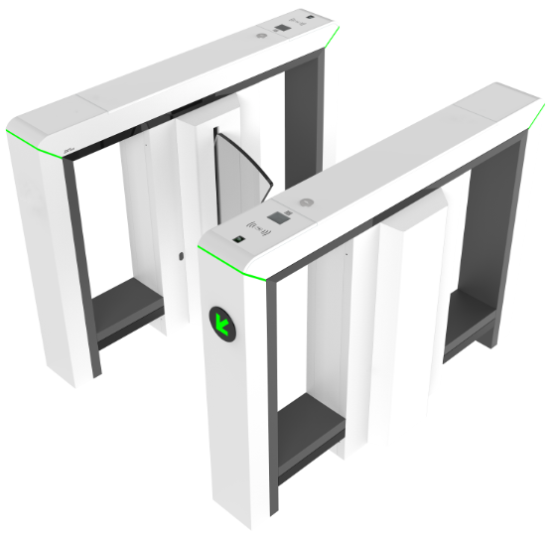
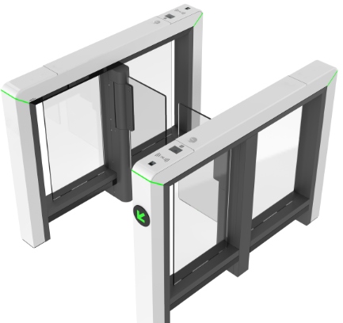
Mars Pro Series of Turnstiles
Premium Version
The premium version is made of SPCC material with white color powder coating.
Mars Pro-F1000 Series
Mars Pro-S1000 Series
Notes:
/G: Glass material used on top lid

Slide 6
Positioning
Model Name | Description | Positioning
Mars-F1000 | Single-lane, with master and slave devices. | Low-end
Mars-F1200 | Dual-lane, an additional barrier turnstile to form multiple lanes. | Low-end
Mars-B1000 | Single-lane, with master and slave devices. | Low-end
Mars-B1200 | Dual-lane, an additional barrier turnstile to form multiple lanes. | Low-end
Mars-S1000 | Single-lane, with master and slave devices. | Low-end
Mars-S1200 | Dual-lane, an additional barrier turnstile to form multiple lanes. | Low-end
Mars Pro-F1000 | Single-lane, with master and slave devices. | High-end
Mars Pro-F1200 | Dual-lane, an additional barrier turnstile to form multiple lanes. | High-end
Mars Pro-S1000 | Single-lane, with master and slave devices. | High-end
Mars Pro-S1200 | Dual-lane, an additional barrier turnstile to form multiple lanes. | High-end

Slide 7
Naming Rules
Model Name | Description
Mars-F1000 | A single-lane flap barrier without readers and access controllers.
Mars-F1011 | A single-lane flap barrier with 2 RFID readers and 1 PGIC controller.
Mars-F1022 | A single-lane flap barrier with RFID and FP readers, plus 1 PGIC access controller.
Mars-F1200 | A dual-lane flap barrier without readers and access controllers.
Mars-F1211 | A dual-lane flap barrier with 2 RFID readers and 1 PGIC controller.
Mars-F1222 | A dual-lane flap barrier with RFID and FP readers, plus 1 PGIC access controller.

Slide 8
02
Modularized Design
Sandwich Structure
Authentication Panel
Reserved a Place for Facial Recognition, Temperature and Mask Detection Terminals
Infrared Sensor Extension

Slide 9
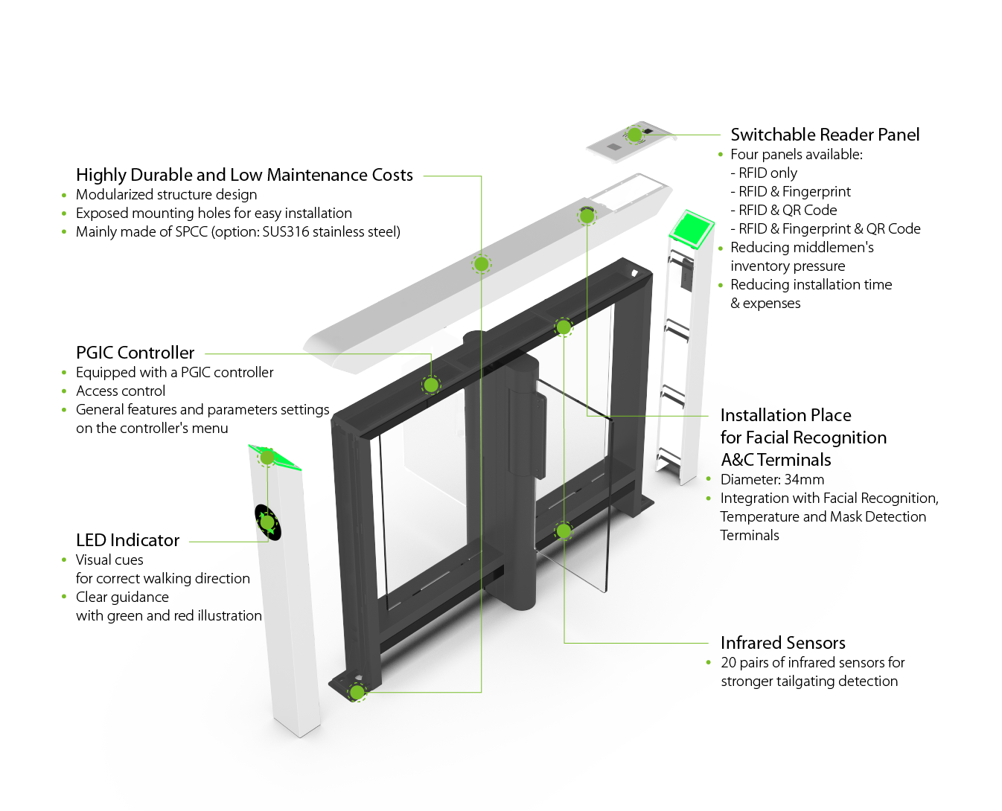
Modularized Design

Slide 10
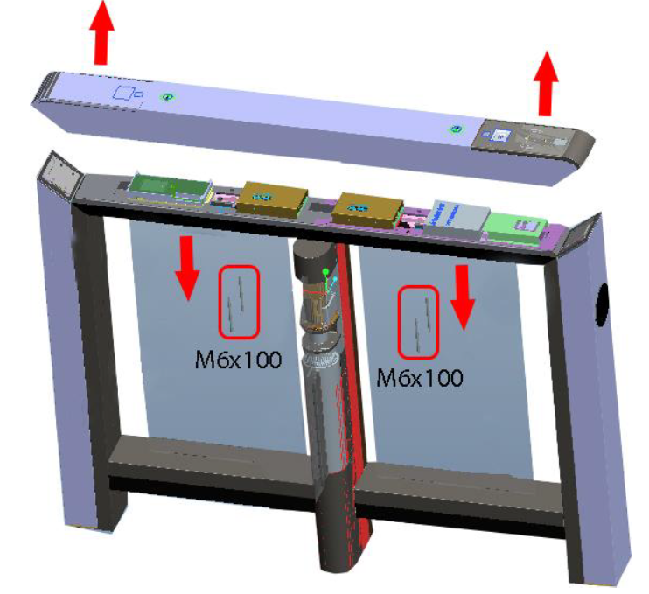
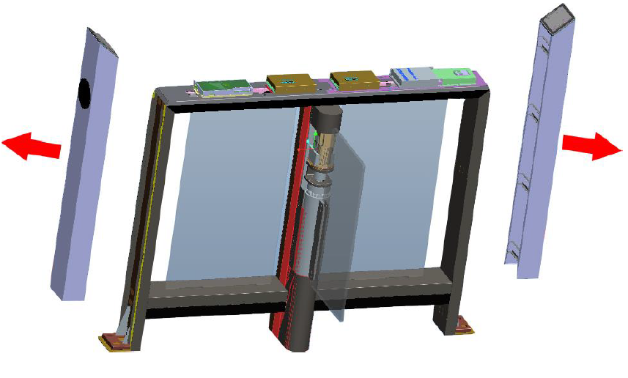
Modularized Design
Sandwich Structure
Note: The Mars Series consists of the main base (dark grey) and the outside cover (light purple).
If you want to access the interior of the turnstile, please refer to the below.
Step 1
Step 2
Notes:
Benefits:
Easy maintenance for outside cabinet cover replacement
Make a components have the ability of material sharing, manufacture was more flexible and improve yield also.

Slide 11
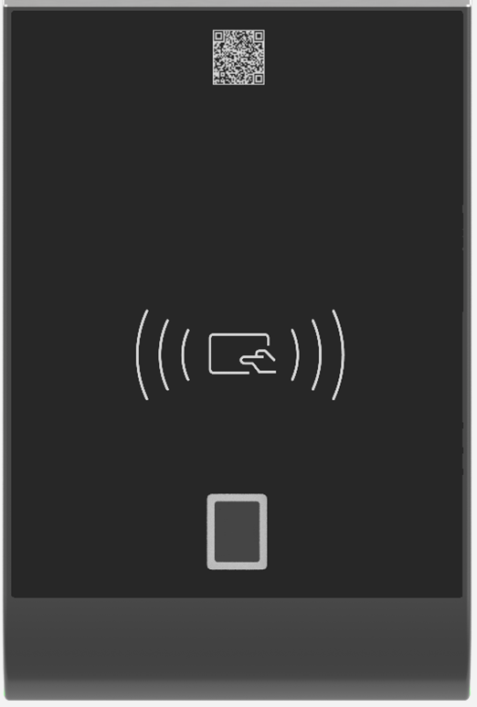
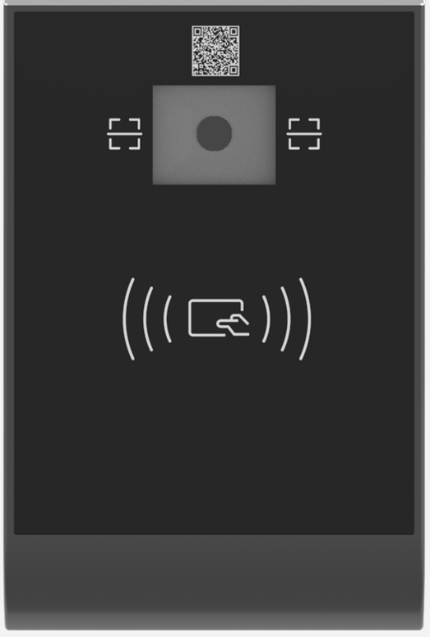
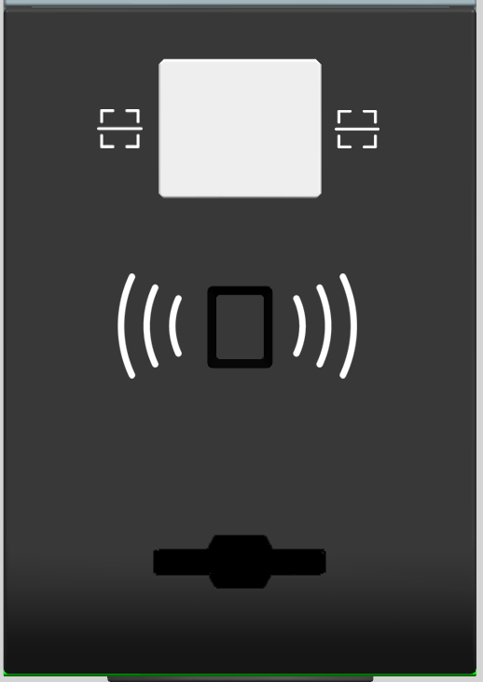
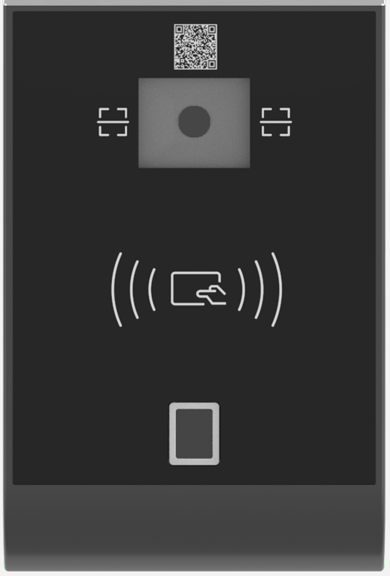
Modularized Design
Authentication Panels
Biometric Technology
Up to 6 types of biometric authentication panels are available.
RFID only
RFID & QR Code
RFID & Card Slot
RFID & Fingerprint
RFID & Fingerprint
& QR Code
RFID & Card Slot
& QR Code
Overhead base

Slide 12
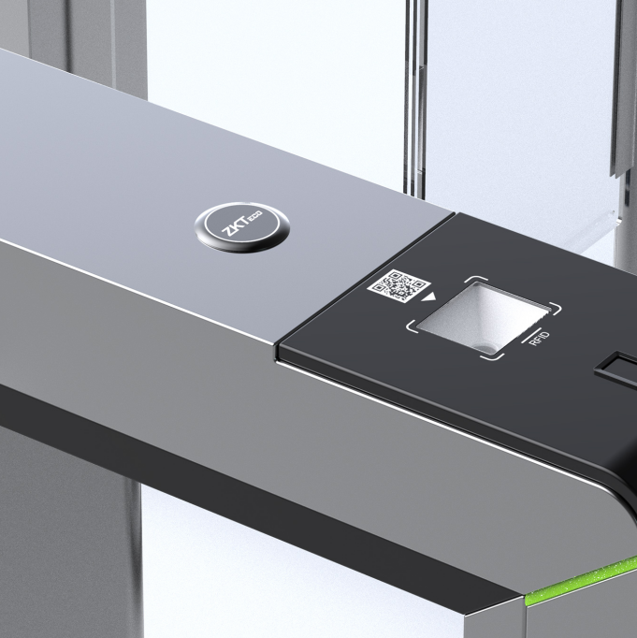
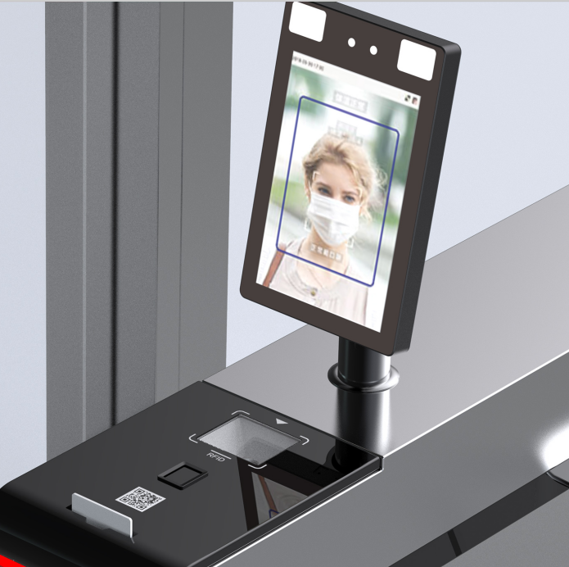
Modularized Design
Reserved a Hole
to Install a Comprehensive A&C Terminal
Reserved a hole with a diameter of 34mm and used a plastic cover to entirely cover this hole.
Clients could mount a facial recognition terminal with mask and temperature detection on the turnstile.

Slide 13
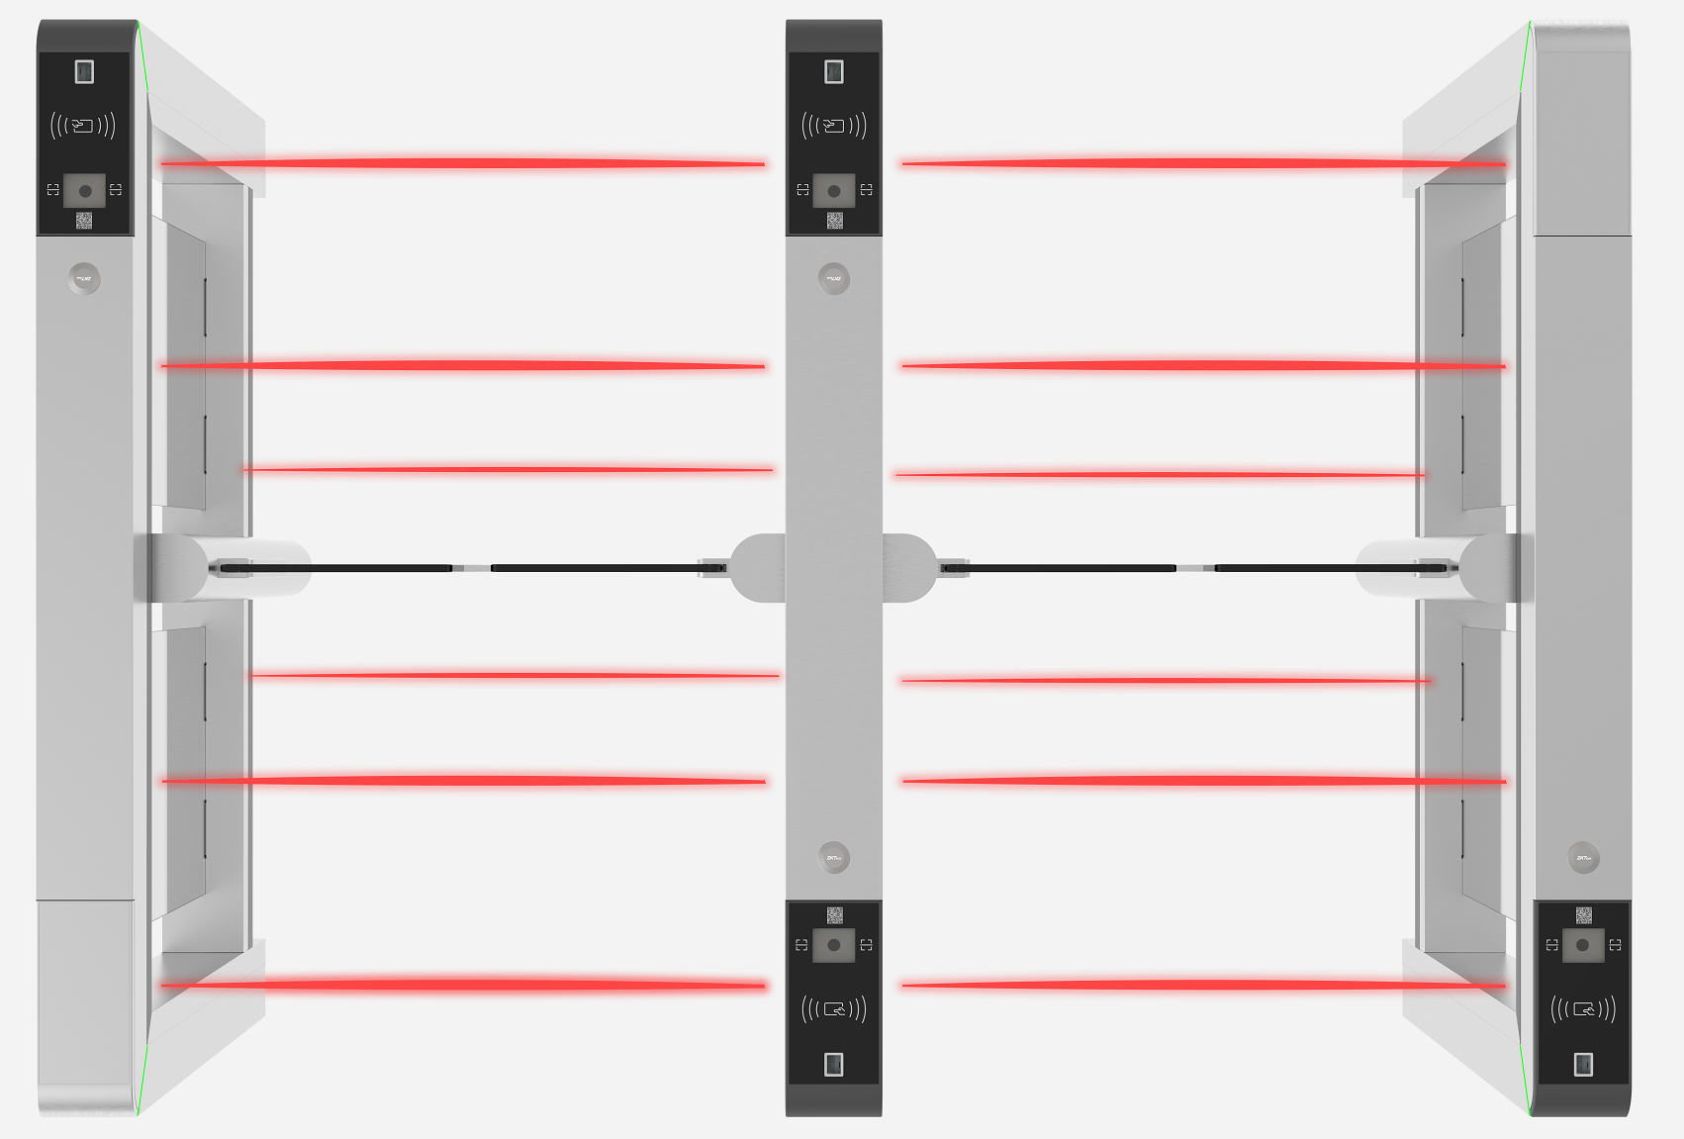
Modularized Design
Infrared Sensor Extension
The Series supports a maximum of 22 pairs of IR sensors, offering more accurate judgment and better anti-tailgating and anti-collision performance.

Slide 14
03
Installation
Lane Width
Base Plate

Slide 15
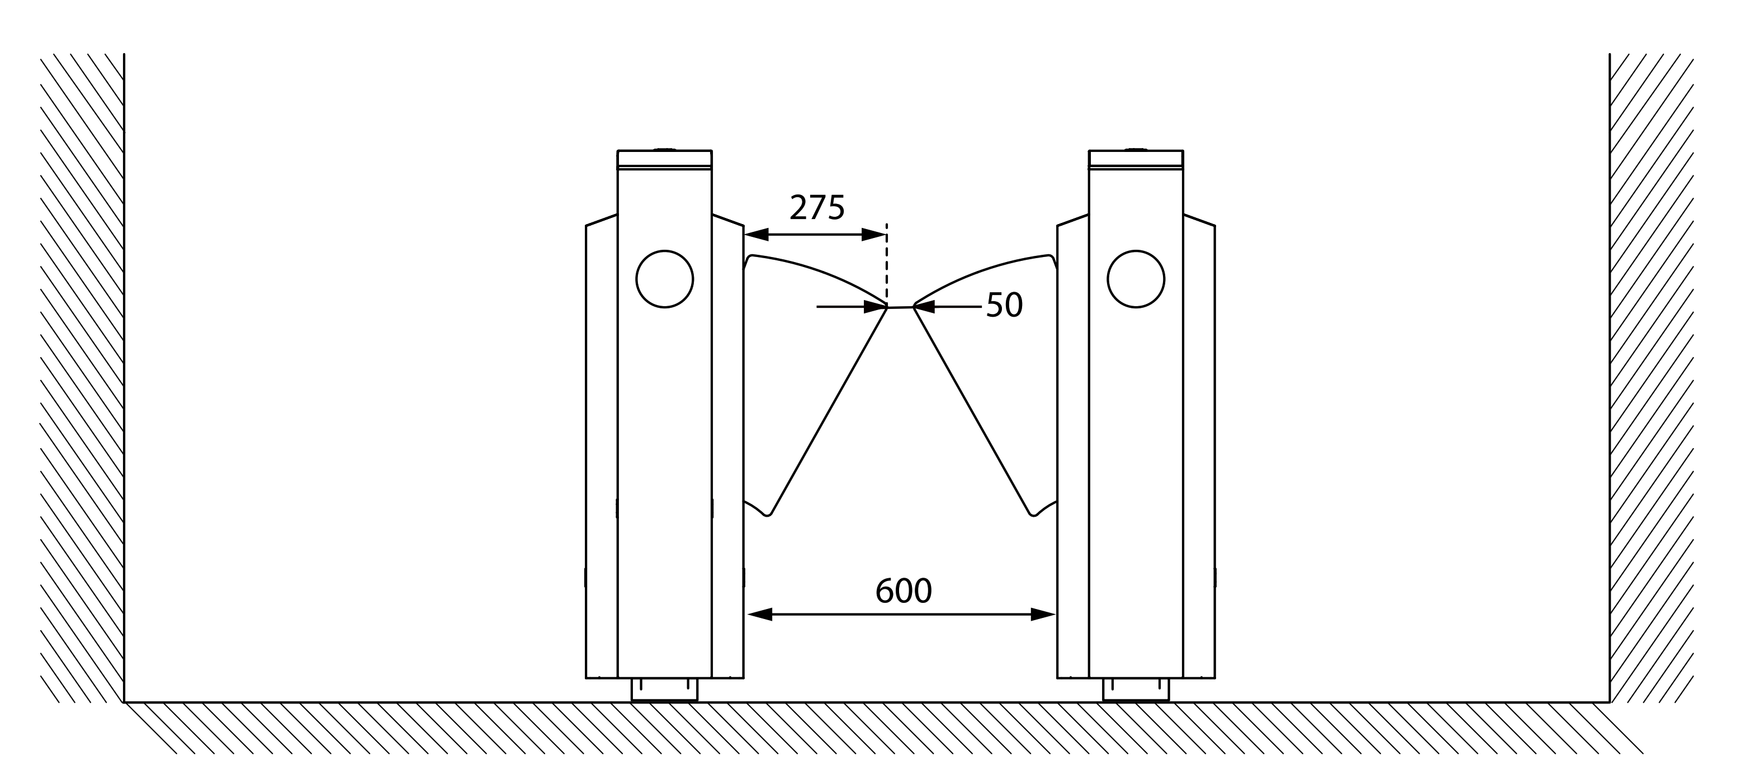
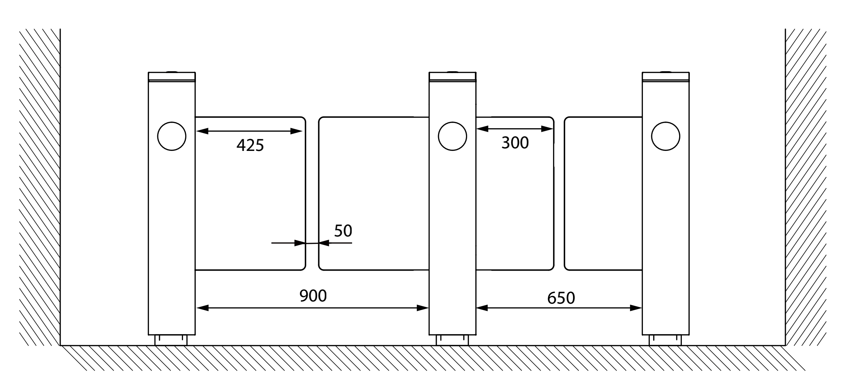
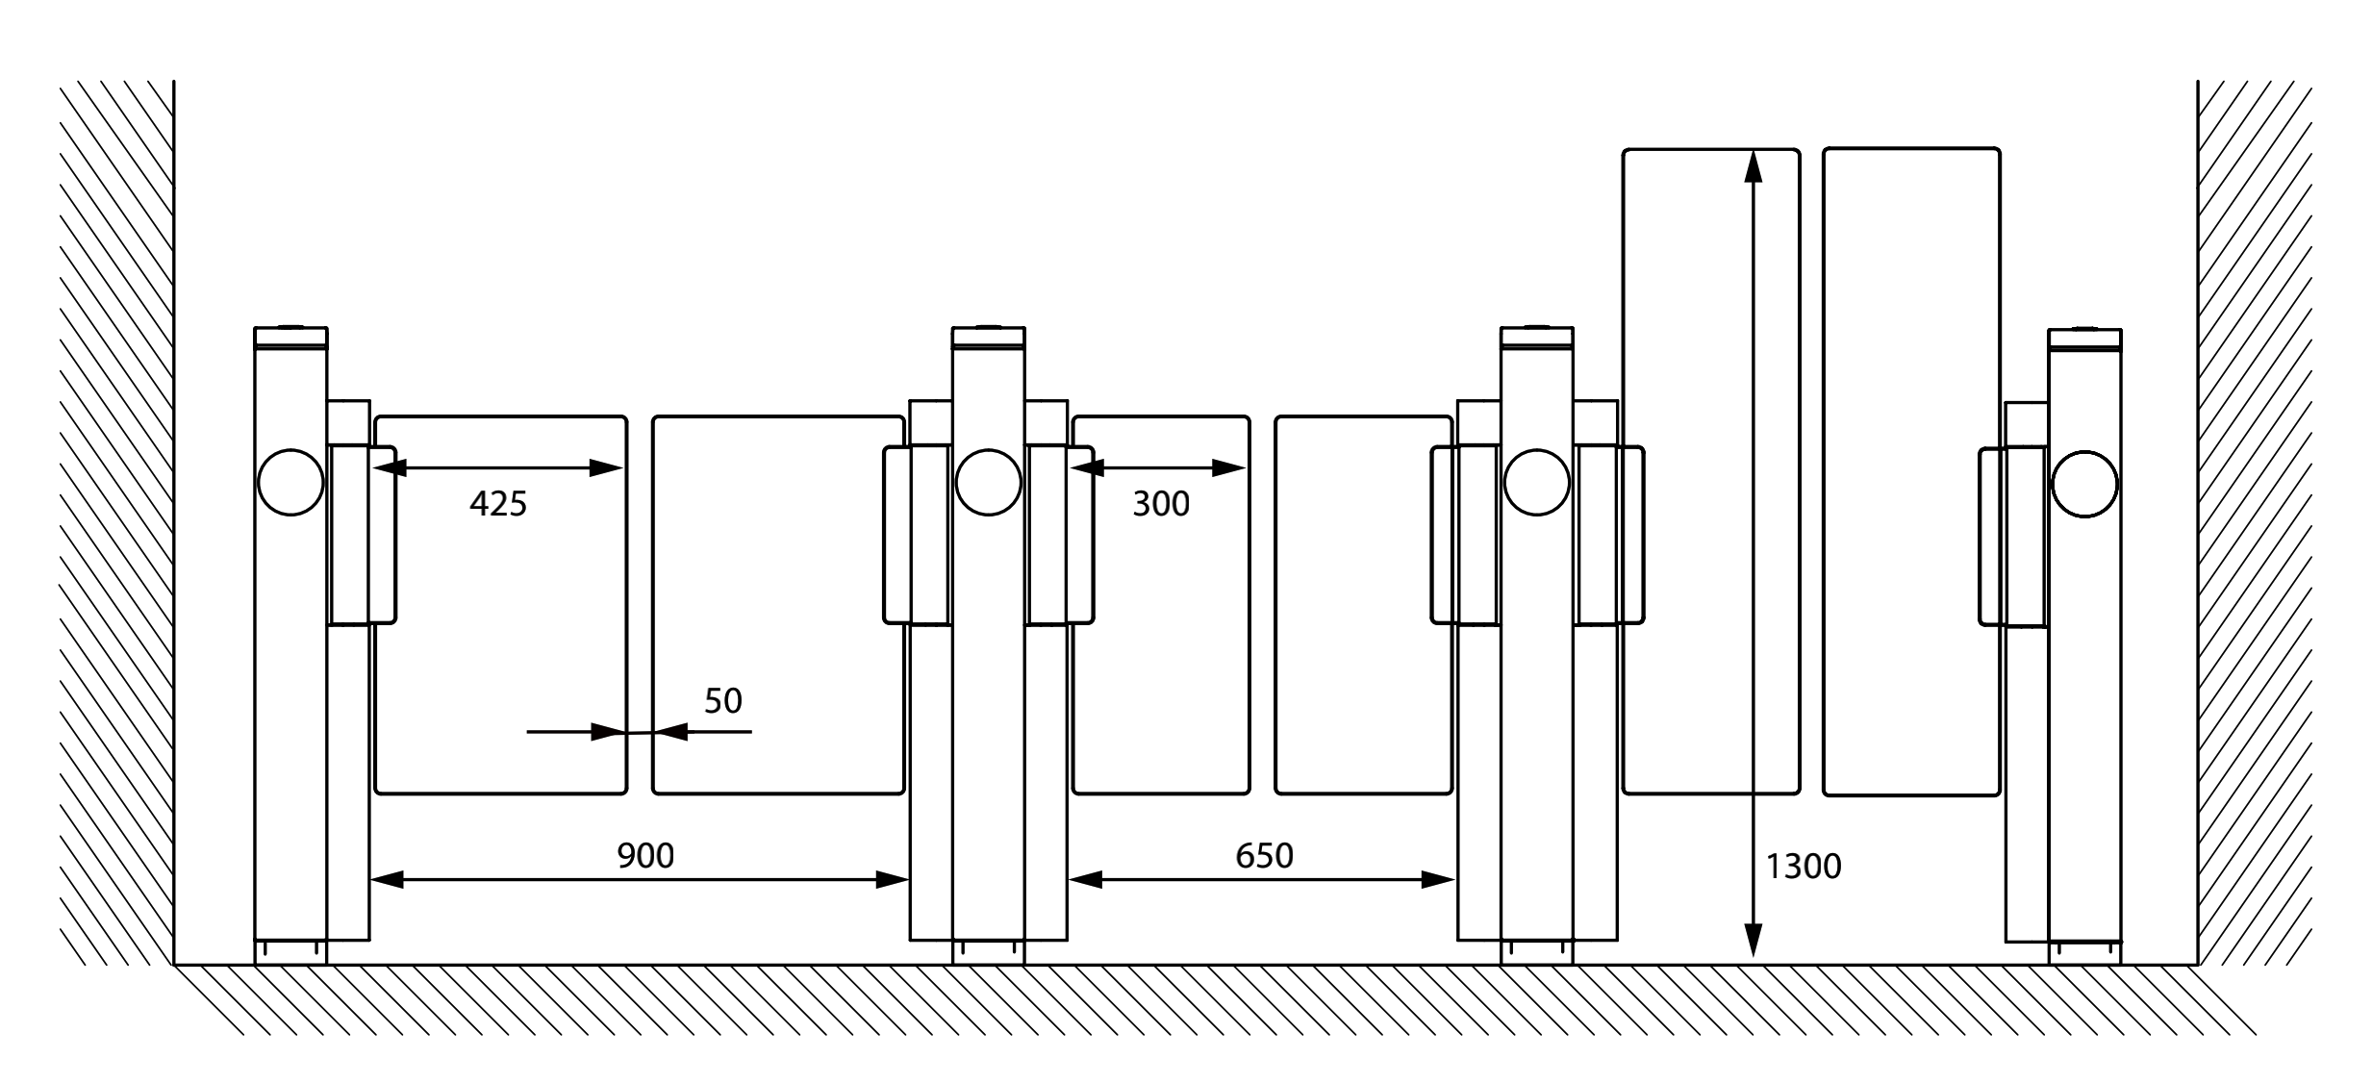
Installation
Lane Width
Clients could choose the lane width as desired.
Model Name | Mars (Pro)-F1000 Series | Mars (Pro)-B1000 Series | Mars (Pro)-S1000 Series
Lane Width or Height | W: 600mm H: N/A | W: 650 to 900mm H: N/A | W: 650 to 900mm H: 1300 to 1600mm
Applications

Slide 16
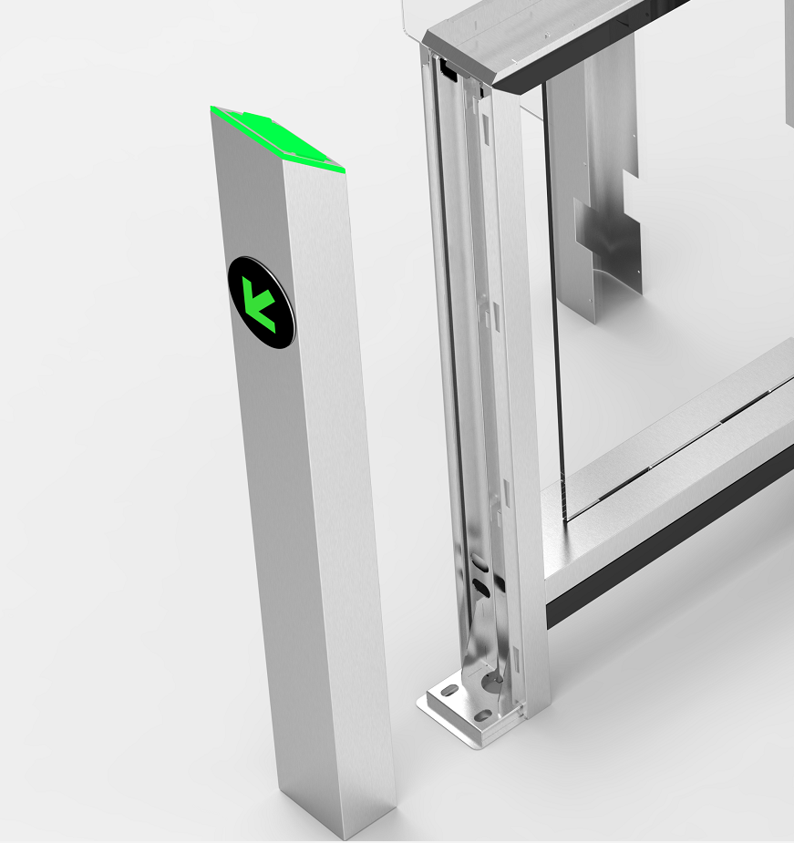
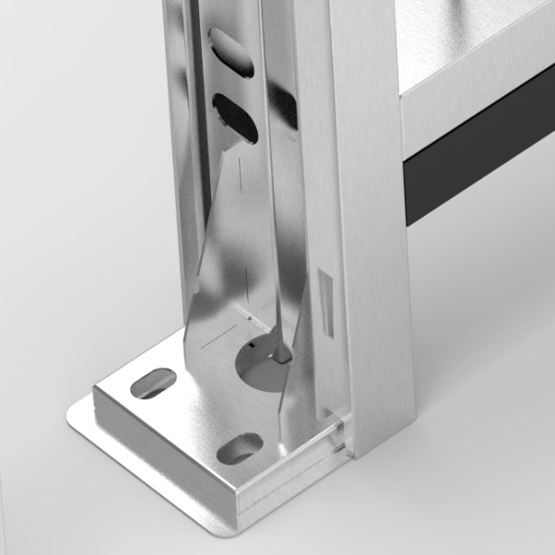
Installation
Base plate
It is easy to fix or uninstall the turnstile on the site with a base plate provided.
For details, please refer to the Installation Guide.
Base plate of one side
Notes:
Note:
Each cabinet have to fix the base plate both side.

Slide 17
Installation
Key Specifications
Model Name | MCBF | Dimensions (mm) | Barrier Material | Emergency Mode | Working Environment | IR Sensor (QTY)
Mars-F1000 Series | 3M | 1360*180*1010 | Acrylic | Y | Indoor | 5 pairs
Mars-B1000 Series | 5M | 1360*180*1010 | Acrylic | Y | Indoor | 6 pairs
Mars-S1000 Series | 5M | 1355*120*1020 | Acrylic | Y | Indoor | 8 pairs
Mars Pro-F1000 Series | 10M | 1360*180*1010 | Acrylic | Y | Indoor | 16 pairs
Mars Pro-S1000 Series | 10M | 1355*120*1020 | Acrylic | Y | Indoor | 20 pairs

Slide 18
Installation
Key Features
COST
Delivery
Flexibility
Modularization: Prices are more competitive, and products could be shipped and delivered more quickly
Access reader panels reduces middlemen’s or users’ inventory pressure and installation time & expenses
Easy installation
Reliability
Only removing 4 pcs screw, you can access all the interior components.
MCBF of the standard version device is proven to be over 2M, while what of the premium version is proven to be up to 10M. The Series supports 5-year warranty.

Slide 19
04
Market Positioning Analysis
Comparison with ZKTeco’s Similar Products
Comparison with Competitors’ Similar Products

Slide 20
Comparison within ZKTeco
Model Name (new ver.) | Model name (old ver.) | Comparison Results
Mars-F1000 Series Brushless motor driver Full modularization More competitive pricing | FBL6000 Pro DC Brush motor Partial modularization Higher costs | Mars-F1000 Series Using brushless motor which has longer life cycle Full modularization design is easy for maintenance More competitive pricing
Mars-B1000 Series Brushless motor driver Full modularization More competitive pricing | SBTL5000/6000 DC Brush motor Partial modularization Higher costs | Mars-B1000 Series Using brushless motor which has longer life cycle Full modularization design is easy for maintenance More competitive pricing
Mars-S1000 Series Brushless motor driver Full modularization SUS304 material 8 pairs of IR sensors | SBTL7000 Brushless motor driver Full modularization SPCC with powder coating 6 pairs of IR sensors | Mars-S1000 Series SUS304 material is more durable 2 more pairs of IR sensors
Mars Pro-F1000 Series Brushless motor driver, 10M MCBF Full modularization More competitive pricing | FBL5000 Pro DC Brush motor driver Full modularization More competitive pricing | Mars Pro-S1000 Series 10M of MCBF, 5-year warranty Full modularization design is easy for maintenance Powder coating with white color
Mars Pro-S1000 Series Servo motor driver, 5 years of warranty Full modularization SPCC material with powder coating | SBTL8000 Servo motor driver Partial modularization SUS304 cabinet material | Mars Pro-S1000 Series 10M of MCBF, 5-year warranty Full modularization design is easy for maintenance Powder coating with white color

Slide 21
Market Positioning Analysis
Price Strategy: higher price–performance ratio than the previous device; improved devices’ performance and design.
SBTL8000
SBTL5000
FBL5000 Pro
FBL6000 Pro
SBTL6000
SBTL7000

Slide 22
Comparison with Competitors’ Products
Type Brand | Flap barrier | Flap barrier | Swing barrier | Swing barrier | Swing barrier
ZKTeco | F1000 MCBF>3m, brushless motor, 5 pairs of IR sensors ($1,500) | Pro FP1000 MCBF>10m, brushless motor, 8 pairs of IR sensors ($3,000) | B1000 MCBF>5m, brushless motor, 6 pairs of IR sensors ($1,600) | S1000 MCBF>5m, brushless motor, 8 pairs of IR sensors ($2,500) | Pro S1000 MCBF>10m, Servo motor, 12 pairs of IR sensors ($4,200)
A | 1 MCBF>5m, brushless motor,5 pairs of IR sensors ($1,300) |  | 2 MCBF>5m, brushless motor. 4 pairs of IR sensors ($1,000) |  | 3 MCBF>5m, brushless motor, 10 pairs of IR sensor ($3,500)
B | 1 MCBF>3m, brushless motor ($2,000) |  |  | 2 MCBF>3m, brushless motor ($3,000)
C |  | 1 MCBF>6M, Servo motor, 12 pairs of IR sensors ($4,000) | 2 MCBF>6M, Servo motor, 12 pair of IR sensors ($5,000) | 3 MCBF>6M, Servo motor, 12 pairs of IR sensors ($7,000) | 4 MCBF>6M, Servo motor, 24 pairs of IR sensors ($9,100)
D |  |  | 1 MCBF>5M, Servo motor, 12 pairs of IR sensors ($5,000) | 2 MCBF>5M, Servo motor, 12 pairs of IR sensors ($6,500) | 3 MCBF>5M, Servo motor, 20 pairs of IR sensors ($8,000)
E |  | 1 MCBF>15M, brushless motor, 13 pairs of IR sensors ($4,000) |  |  | 2 MCBF>15M, brushless motor, 8 pairs of IR sensors ($4,000)

Slide 23
05
Applications
Sports Halls
Elevator Lobbies
Offices

Slide 24
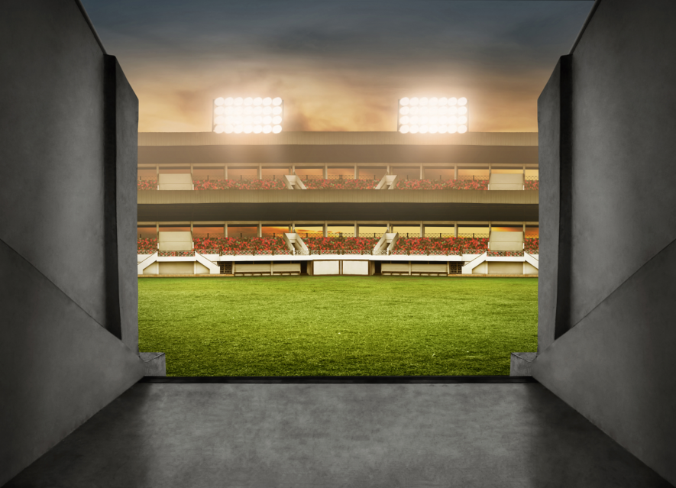
Applications
Sport Halls
Device recommended: Mars-B1000 Series
Obvious indicator guidance
Anti-collision for core mechanism
Wide lane width of 900mm
IR sensors that detect abnormal situation and trigger alarm

Slide 25
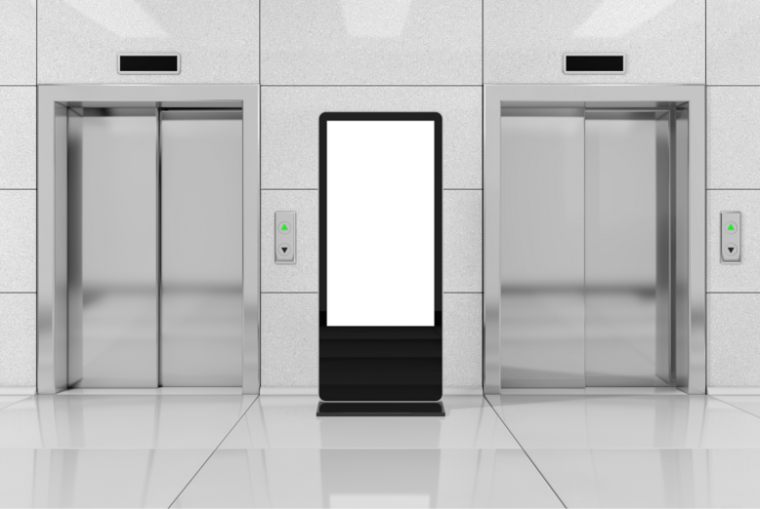
Applications
Elevator Entrances
Device recommended: Mars-S1000 Series
Obvious indicator guidance
Faster opening/closing speed
Wide lane width of 900mm
Different multi-biometric identification reader panels available

Slide 26
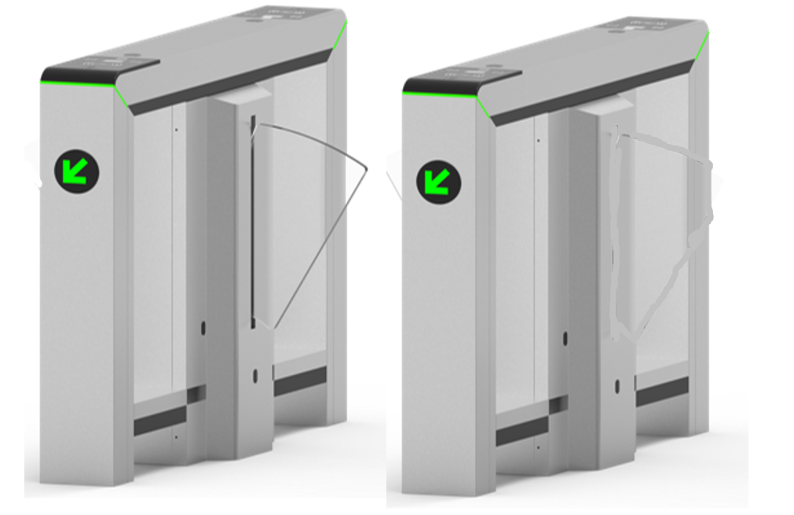
Applications
Office Areas
Device recommended: Mars-F1000 Series
Obvious indicator guidance
Faster opening/closing speed
Automatic opening during emergency
Different multi-biometric identification reader panels available

Slide 27
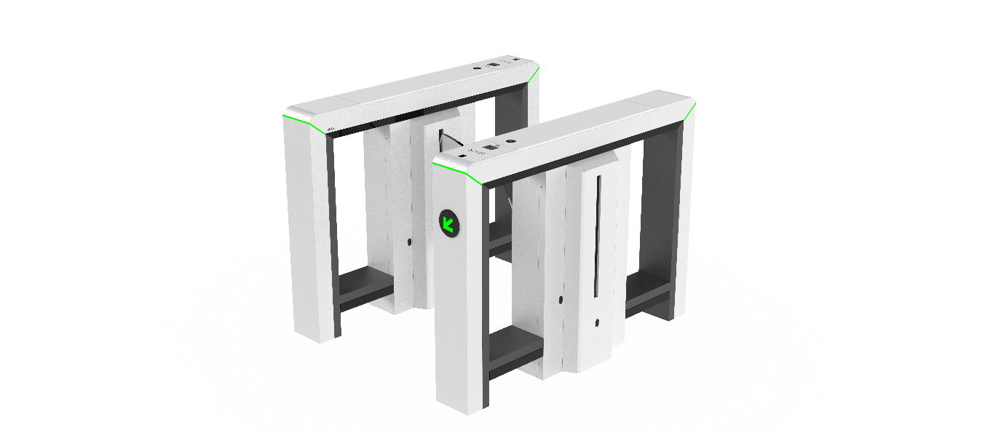
Applications
Stations
Device recommended: Mars Pro-F1000 Series
Obvious indicator guidance
Faster opening/closing speed
Automatic opening during emergency
Different multi-biometric identification reader panels available
MCBF up to 10 millions

Slide 28
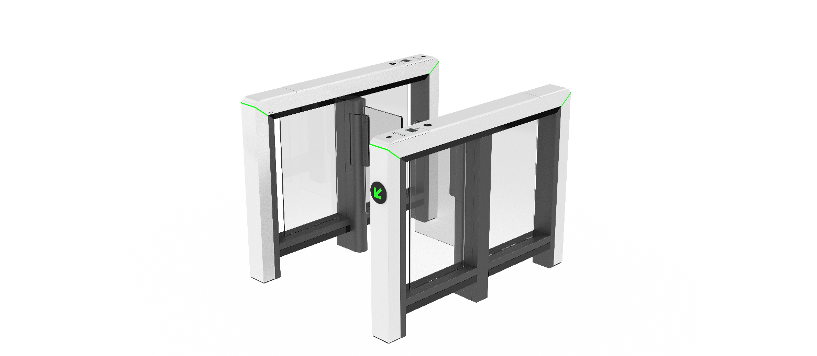
Applications
Exhibition Centers
Device recommended: Mars Pro-S1000 Series
Obvious indicator guidance
Faster opening/closing speed
Wide lane width of 900mm
Different multi-biometric identification reader panels available
MCBF up to 10 millions

Slide 29
BIOMETRICS & COMPUTER VISION
THANK YOU!

